Slide 1

KARS Training: Project Management
Kansas Office of Information Technology Services
July 2023

Slide 2
Project Management

Slide 3
Introductions
Any new attendees?
Name
Role
Project Management Workflow
What are your Expectations from Project Management?
Matt Soccio – Cask Sr. Business Advisor
Matt.Soccio@caskllc.com
Theresa Bednarek – Cask Business Consultant
Theresa.Bednarek@caskllc.com

Slide 4

Training Audience
This training is for individuals starting the KITO project management process. The training may be utilized for any role throughout the Governance and Delivery Process to gain an understanding of Project Management functionality in ServiceNow, and where it fits into and supports the end-to-end process.

Slide 5
Project Management for KITO Staff
Training Agenda
Basic ServiceNow Navigation
Navigation
Favorites
History
Working with Lists
Project Management Overview
Project Management End-to-End Process
Process Objectives
Process Roles
Project Phases
Basic Navigation of Project Form, Project Related Lists
Managing a Project through its Lifecycle
Knowledge Outcomes
How to complete a Project form
Managing Project stakeholders for approvals
Completing Compliance Requirements
Enter and maintain Project Tasks and Milestones
Updating project dates, financials and risks
Reporting

Slide 6
How will this impact me?
Why are we doing this at KITO:
To comply with legislation requiring review and accountability for proposed high value IT projects.
ServiceNow provides the required workflow to ensure all reviews, risk assessments, approvals, etc., are completed at the right time with the necessary information for a project.

Slide 7
Basic Navigation for ServiceNow

Slide 8
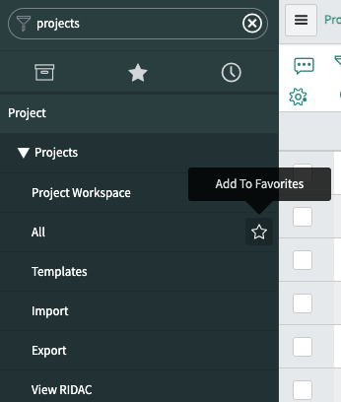
Application Navigator and Favorites
1
1. Using the Application Navigator
Type in the Application Navigator search field to find what you need in ServiceNow.
In this example, by typing ‘Projects’ in the navigator, it is a faster way to find the applications you want.
2. Creating a Favorite
Click on the star icon to the right of the topic. You may either individually create a favorite of a single topic such as Project > Projects > All or select Project at the top level to make all child topics a favorite.
Favorites are shown when you click on the star icon below the Application Navigator
3. Using the History feature
The clock icon below the Application Navigator lists your history of recently viewed records with the most recent at the top. Use this feature to quickly go back to a record,
3
2

Slide 9
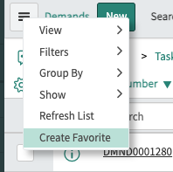
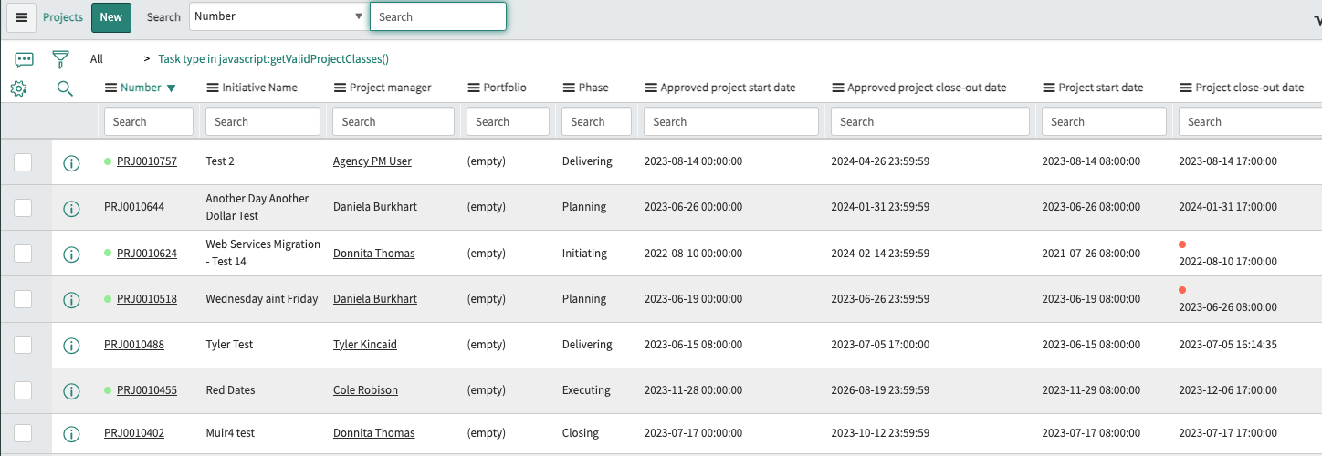
List View
List View shows data from a specific table in ServiceNow. In the example below, each column is a data field on the Project record.
1. The Context Menu allows you to create your personalized list view as a Favorite.
2. The filter allows you to create a specific search for records without changing your list view.
3. The gear icon allows you to personalize the list view to move columns left or right, as well as add or remove columns.
1
2
3

Slide 10
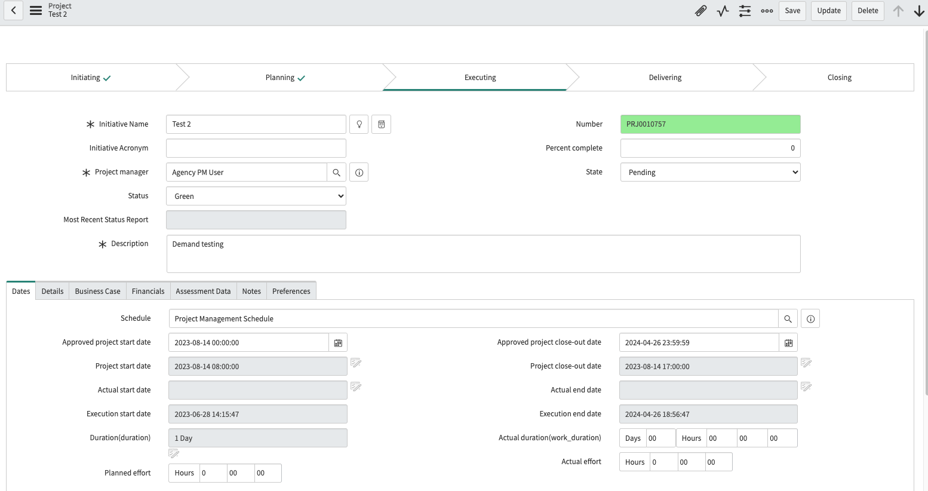
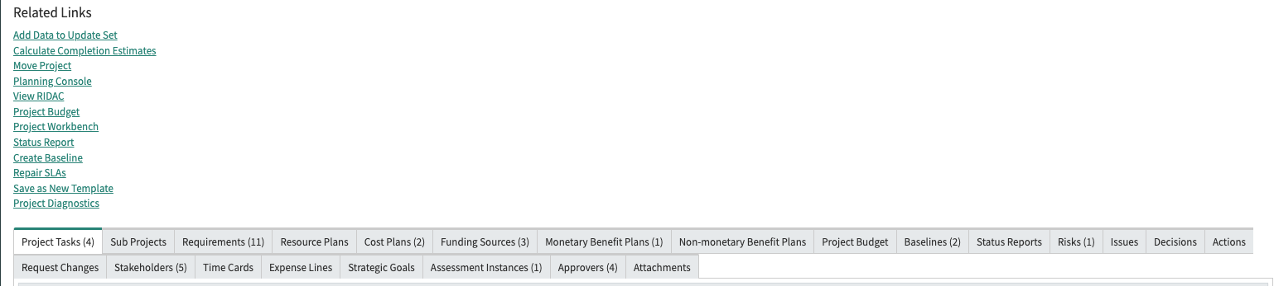
Form Basics
1. Form
User interface buttons
Update: Saves your record and closed it.
Save: Saves your record and stays on the record.
Delete: Deletes the record (may not be visible to all demand users)
2. Tabs
Additional information for the record
3. Related Links
Actions that can be taken from demand.
4. Related Lists
Links to other information that will be shared with a project record
1
2
3
4

Slide 11
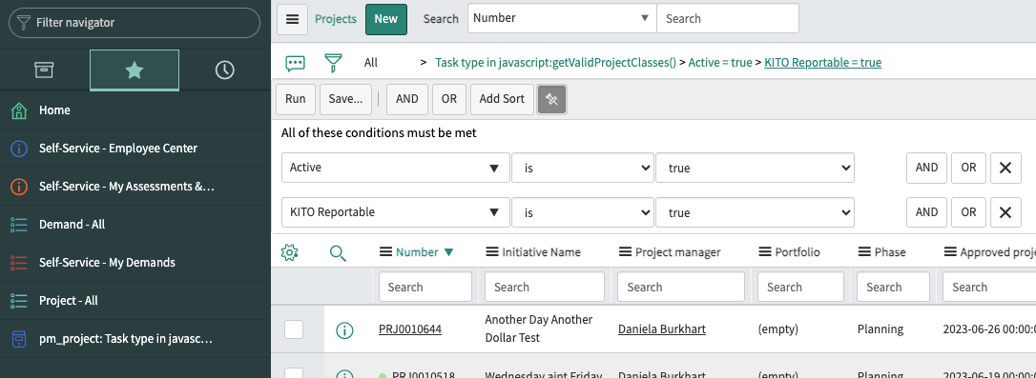
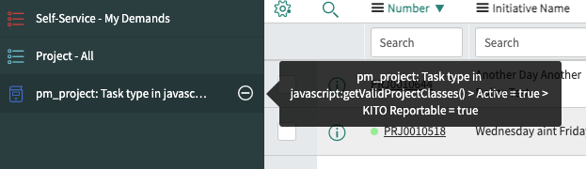
Creating a Favorite
Another way to create a favorite is to ‘drag and drop’ the breadcrumbs from your filter to the Application Navigator column.
1. Use the filter to set the conditions of the data you wish to see. The example below is to see all active projects that are KITO Reportable. With your mouse, click on the breadcrumbs (Task type = Demand > KITO Reportable (Active = true > KITO Reportable = true), and drag it to the left to the Application Navigator column.
2. Hovering over the newly created favorite, you will see the breadcrumbs.
3. Under the Favorites icon, your favorite is shown.
3
1
2

Slide 12
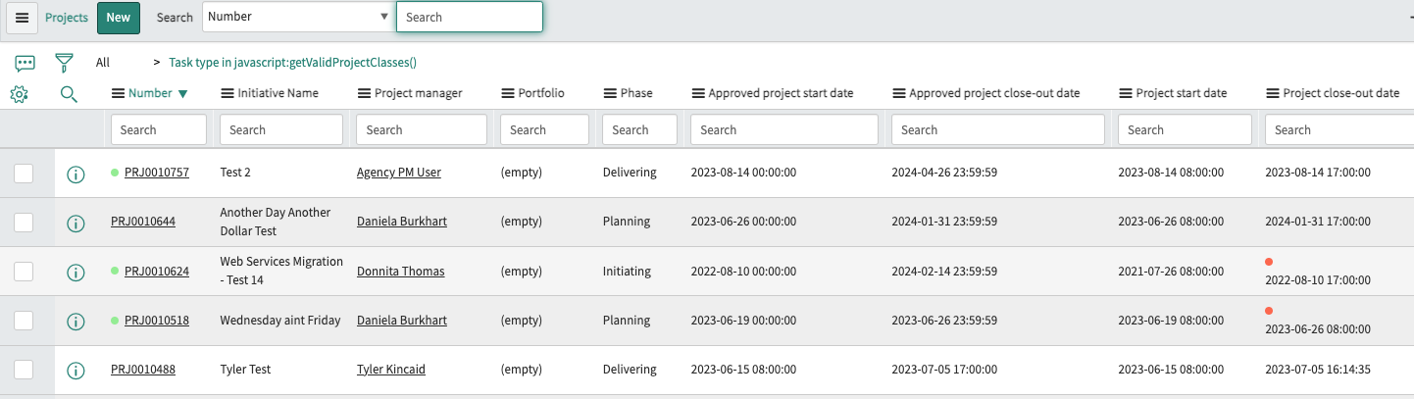
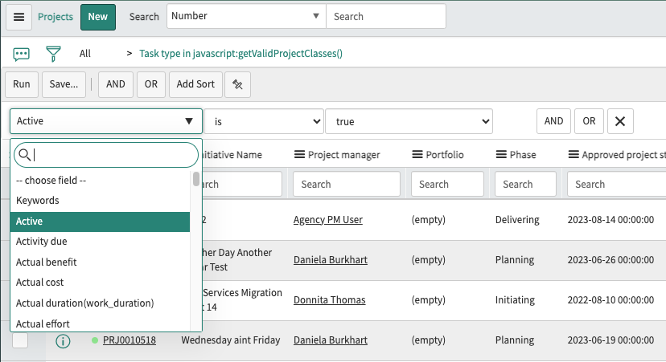
Filtering Your List View
Filtering your list view allows you to view specific data. The filter icon allows you to search for fields to view this data in a list view.
1. Click on the filter icon. The ‘Run’, ‘Save’, ‘AND’, ‘OR’, ‘Add Sort’ and pin icon become available.
Run: when you have completed your filter, click on this button to see the data results.
Save: allows you to save this specific view
AND, OR: when searching for data, you may create a view that searches for multiple variables
Add Sort: allows you to add to your order results (e.g., Assignment group a to z, Active a to z)
Pin icon: allows you to set the filter so it may be easily used on a specific list view
1
2
3

Slide 13

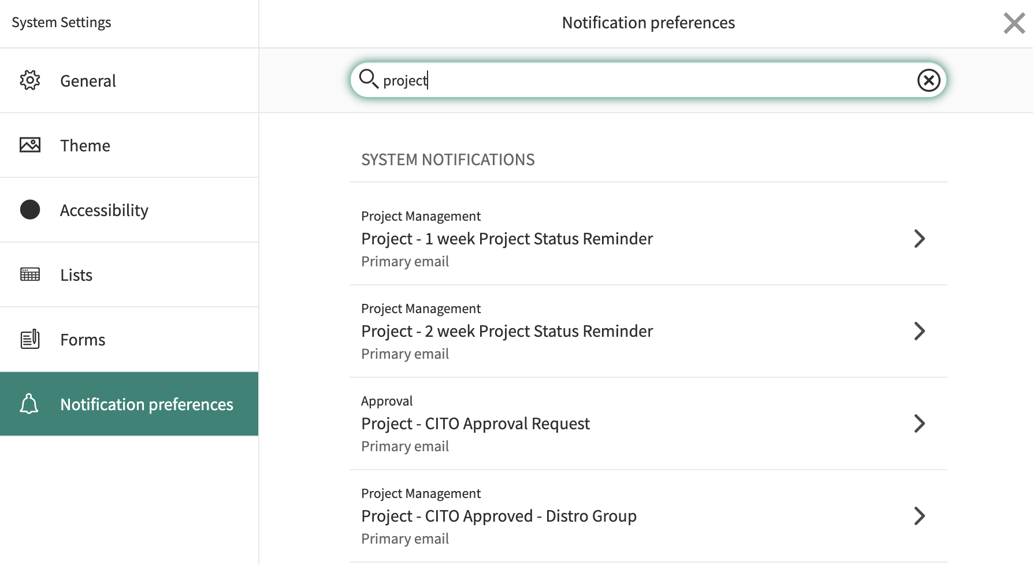
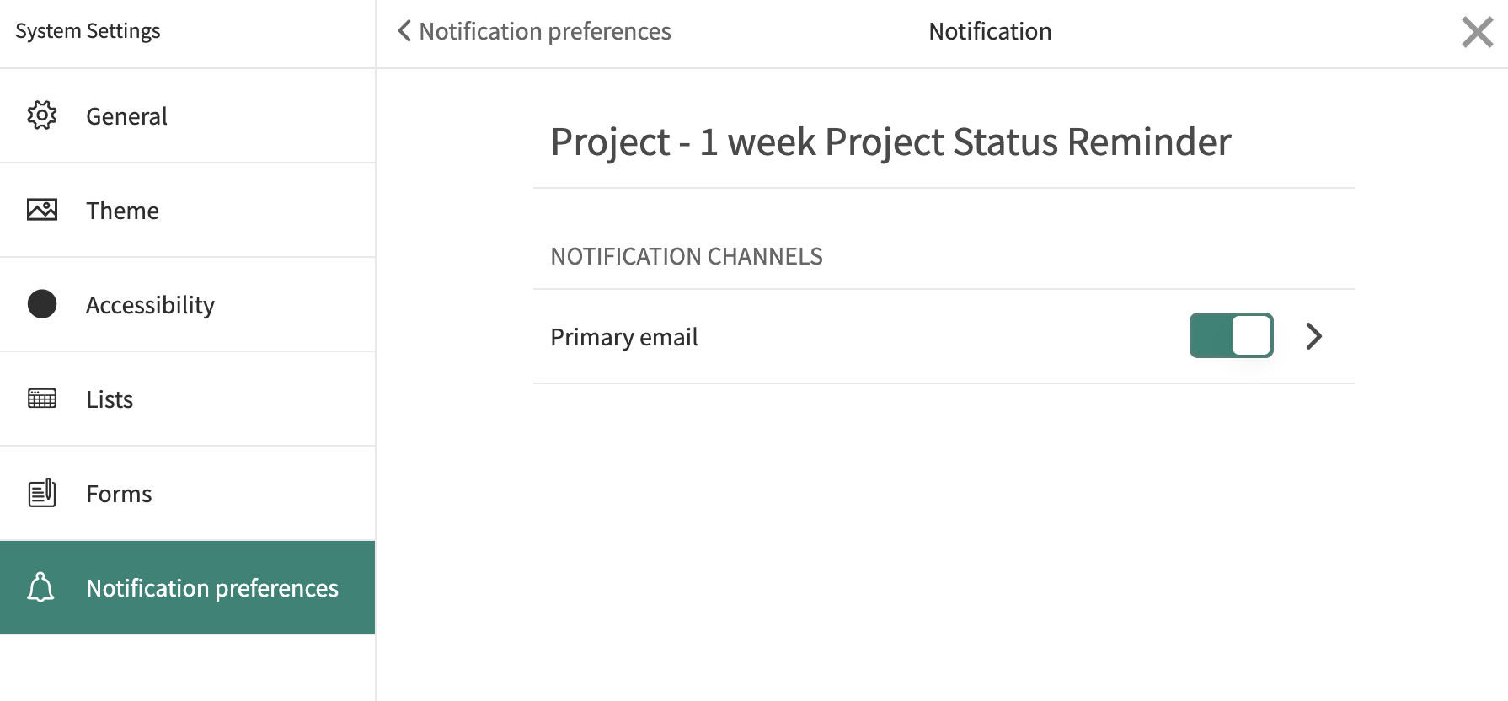
Notifications Management
ServiceNow can send a lot of notifications to email. Setting preferences in ServiceNow instead of filtering everything as it comes to your Inbox will ensure you see the emails you need to see. You will not get notifications for events that you trigger.
In the upper right, click on the gear icon. System Preferences will open, navigate to the Notification Preferences section.
Search for ‘demand’ (or other types of records in ServiceNow) and select the notification you want to change.
Use the slider to toggle messages on or off.
1
2
3

Slide 14
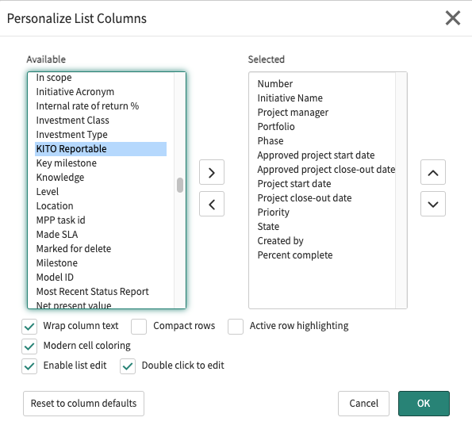
Personalize Your List View
List View shows the data from a specific table in ServiceNow. In the example below, each column is a data field on the record.
The gear icon allows you to personalize the list view to move columns left or right, as well as add or remove columns.
Find the field you want to display, move it from ‘Available’ to ‘Selected’ by clicking on the arrow. You may also move fields under ‘Selected’ by selecting the field and moving it to ‘Available’.
To personalize the list view from left to right, in the ‘Selected’ column, move fields to the top in the order you wish to view them from left to right.
Click the ‘OK’ button.
1

Slide 15



User Interface Buttons
ServiceNow uses User Interface (UI) buttons at the top of their forms in all their applications.
Save – saves the record and stays on the record.
Insert & Stay – creates a copy of the current record with any modified values, and redirect to the new record.
Update - saves the record and closes it.

Slide 16
Project Management Overview

Slide 17
IT Demand Request to Project
Demand
Stakeholders
Assessments / Approvals
Benefit / Cost Plans
Funding Sources
Tasks / Requirements
Project
Planning / Tracking
Status Reports
Approvals
Benefit / Cost Plans
Tasks
IT Demand
Demand
Intake
Approved
Demand
OITS Service Portal

Slide 18
Project Management: Process Flow
Initiating
Planning
Executing
Delivering
Closing
Assign Project Manager
Verify information from approved Demand (e.g., Cost Plans, Benefit Plans, Stakeholders, Requirements)
Baseline from approved Demand created
Define Schedule(Build WBS with Milestones)
Identify Project Team
Project Risk Assessment
Compliance Requirements
Agency Executive Authority Requirement
Baseline Project
Begin Work (Project begins with CITO approval)
Update Tasks
Manage Communications
Manage Risks,
Issues
Status Reporting for Quarterly Status Reports
Testing
Update tasks and milestones
Training
Operational documentation
Organizational change
Post-Implementation Evaluation Review – PIER Report
Close Project

Slide 19
Process Objectives
Project Management
Process Goal:
Apply the appropriate knowledge, tools and techniques to project activities in order to meet project requirements for IT projects that are KITO Reportable.
Process Objectives:
Identify project requirements
Address project stakeholders’ various needs, concerns and expectations throughout the project life cycle
Facilitate and maintain collaborative project communications among project team members and stakeholders
Manage stakeholder expectations and satisfaction concerning requirements and deliverables
Stabilize competing demands such as project resources, budget, schedule, scope, issues and risks
Process Relationships:
When Demands are Approved, they will become Projects
Cost Plans, Benefit Plans, Requirements and RIDACs are brought to the Project from the approved Demand

Slide 20
Process Roles
Project Manager for KITO Projects:
Manage and update their assigned Project records.
Activities
Managing the day-to-day activities of the project
Driving the efficiency and effectiveness of the project management process
Recruiting, building and leading an effective project team
Ensuring project progress by managing the interaction of project tasks
Managing issues to reduce risks, maximize benefits and restrict costs
Status reporting for Quarterly Status
Project User:
They are assigned to project tasks.
Activities
Assigned to and working on project tasks
Communicating project task status, issues and risks
Producing project task deliverables

Slide 21
Project Management Phases
Initiating | Planning | Executing | Delivering | Closing
Project created from approved Demand Assign Project Manager Cost Plans, Benefit Plans, RIDACs, Stakeholders, Requirements brought over from Demand to Project | Project Risk Assessment Agency Executive Authority approval Compliance Requirements acceptance and approval WBS with Milestones created KITO review and acceptance CITO approval | Project automatically executes with CITO approval Update Project data (e.g., complete Tasks, set milestones as complete, make adjustments if dates change) | Update Project data (e.g., complete Tasks, set milestones as complete, make adjustments if dates change) | Project complete, update Project record

Slide 22
Initiating Phase

Slide 23
Project Management: Process Flow
Initiating
Planning
Executing
Delivering
Closing
Assign Project Manager
Verify information from approved Demand (e.g., Cost Plans, Benefit Plans, Stakeholders, Requirements)
Baseline from approved Demand created
Define Schedule(Build WBS with Milestones)
Identify Project Team
Project Risk Assessment
Compliance Requirements
Agency Executive Authority Requirement
Baseline Project
Begin Work (Project begins with CITO approval)
Update Tasks
Manage Communications
Manage Risks,
Issues
Status Reporting for Quarterly Status Reports
Testing
Update tasks and milestones
Training
Operational documentation
Organizational change
Post-Implementation Evaluation Review – PIER Report
Close Project

Slide 24
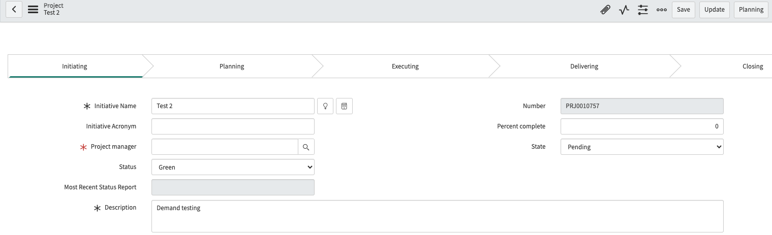
Initiating: Review Record
In Initiating state, navigate to Project > Projects > All to review the project record for completeness.
Project manager: Populate with project manager assigned to the project. This is a required field.
Related Lists: Review information from the approved demand (e.g., Requirements, Cost Plans, Funding Sources, Benefit Plans, RIDACs, Goals) and add additional information as necessary to prepare for the Planning state.
1
2

Slide 25

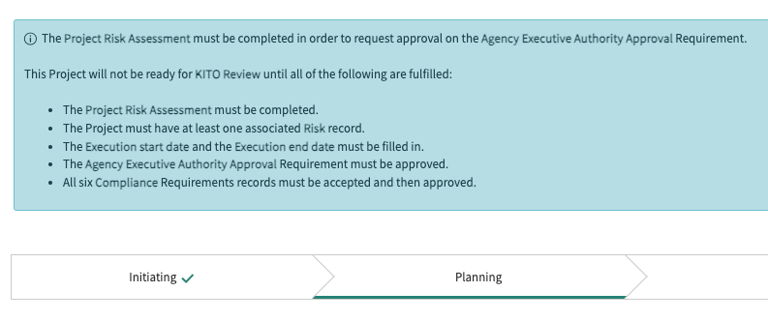
Move to Planning
When the project is ready for planning, click on the ‘Planning’ button in the header.
The project workflow will reflect the project is in the Planning phase.

Slide 26
Planning Phase

Slide 27
Project Management: Process Flow
Initiating
Planning
Executing
Delivering
Closing
Assign Project Manager
Verify information from approved Demand (e.g., Cost Plans, Benefit Plans, Stakeholders, Requirements)
Baseline from approved Demand created
Define Schedule(Build WBS with Milestones)
Identify Project Team
Project Risk Assessment
Compliance Requirements
Agency Executive Authority Requirement
Baseline Project
Begin Work (Project begins with CITO approval)
Update Tasks
Manage Communications
Manage Risks,
Issues
Status Reporting for Quarterly Status Reports
Testing
Update tasks and milestones
Training
Operational documentation
Organizational change
Post-Implementation Evaluation Review – PIER Report
Close Project

Slide 28
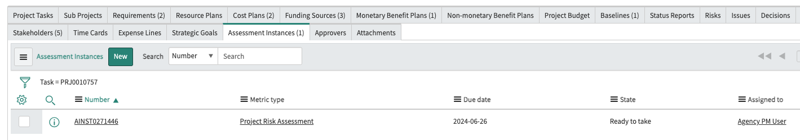
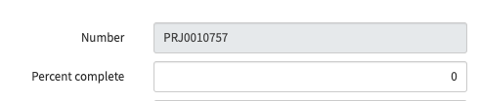
Planning: Project Risk Assessment
A Project Risk Assessment is generated and must be completed by the project manager.
Navigate to the Assessment Instances Related List to confirm an assessment was created. The assigned project manager may take the assessment by clicking on the assessment instance number.
The project manager may also navigate to Self-Service > My Assessments & Surveys to take the assessment.
Note the project number to easily find your assessment.

Slide 29
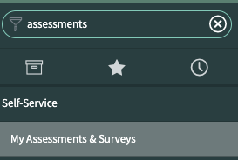
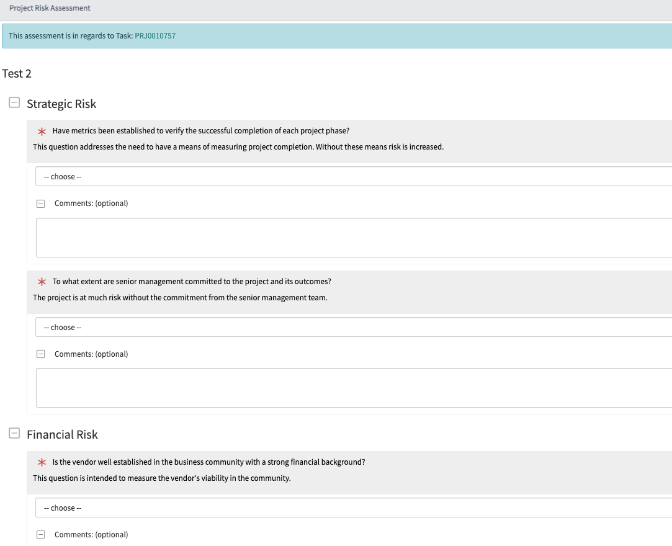
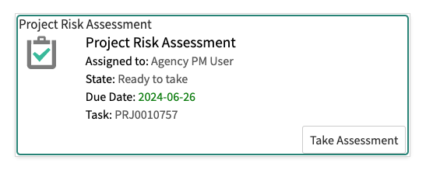

Planning: Project Risk Assessment
1. Navigate to Self-Service > My Assessments & Surveys to find the assessment. Note the project number to find your assessment more easily if there are multiple assessments pending.
2. Click on the ‘Take Assessment’ button.
3. You may save your work on the assessment to complete later by clicking on the ‘Save’ button. When you are ready to complete it, click on the ‘Submit’ button. You may not retake or edit the assessment once it is submitted.
1
2
3

Slide 30
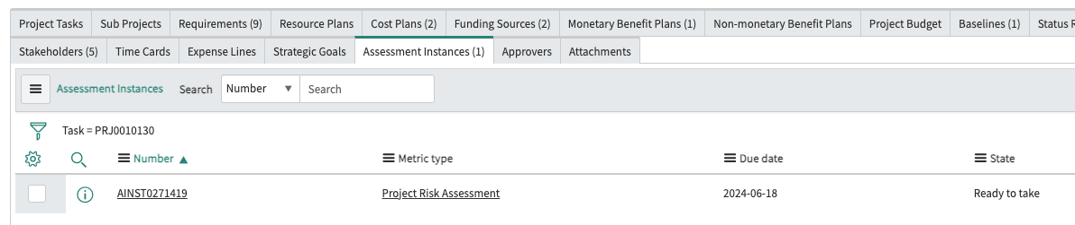
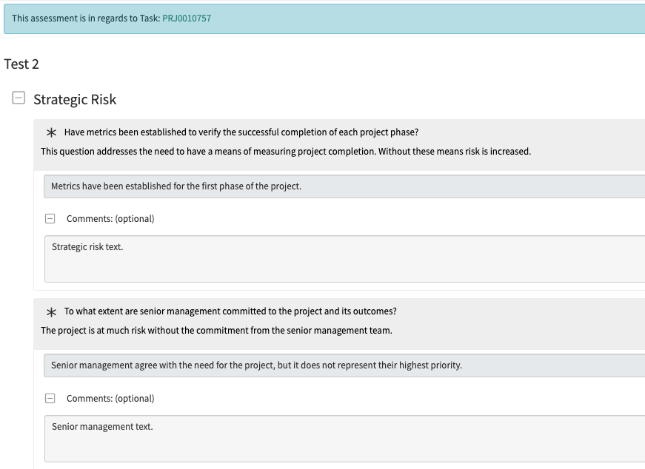
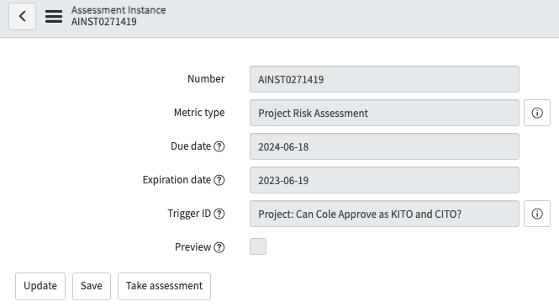
Planning: Project Risk Assessment
1. From the Assessment Instances Related List, click on the ‘Number’ column. Do not click on any other column because this will not lead to opening the assessment.
2. Click on the ‘Take Assessment’ button on the Assessment Instance record which will open the assessment.
NOTE: You cannot retake or edit the assessments once they are submitted. It is critical to collaborate and fill it out accurately.
1
2

Slide 31
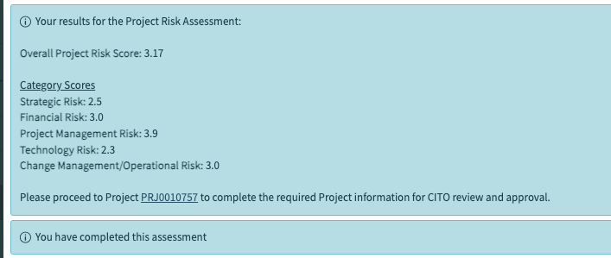
Planning: Project Risk Assessment
When the assessment is completed, the risk evaluation scores will be shown.
You will be prompted to complete the required Project information for CITO review and approval.

Slide 32
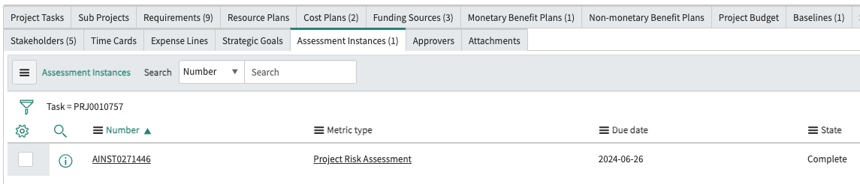
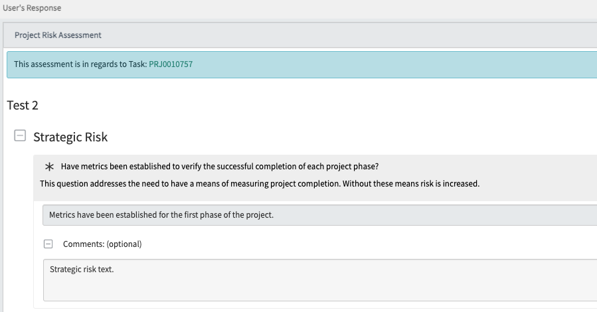
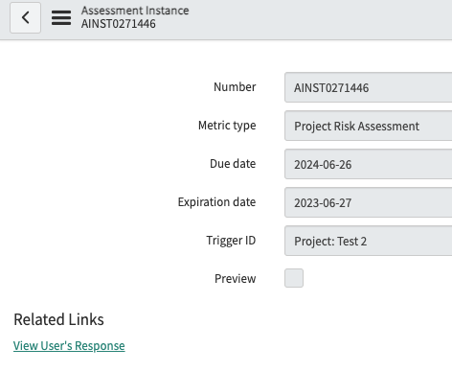
Planning: Viewing the Project Risk Assessment
When the assessment is completed, you may view the assessment by clicking on the Assessment Instance number.
On the Assessment Instance record, click on the ‘View User’s Response’ link under Related Links.
The completed assessment may be viewed. It is possible
1
3
2

Slide 33
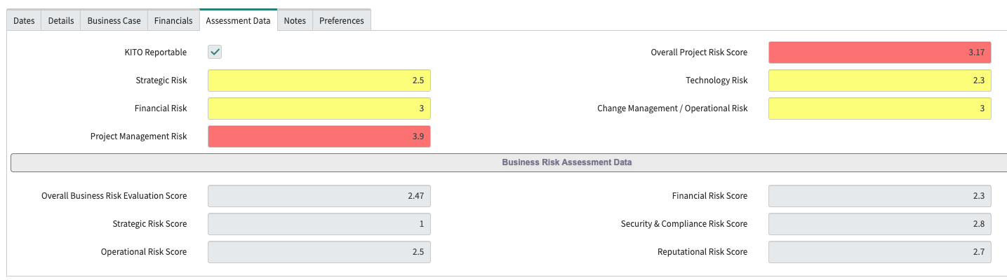
Planning: Project Risk Assessment Results
On the Assessment Data tab, you may view the results of the Project Risk Assessment. Fields are color coded based on their score.

Slide 34
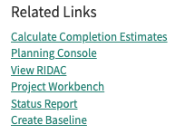
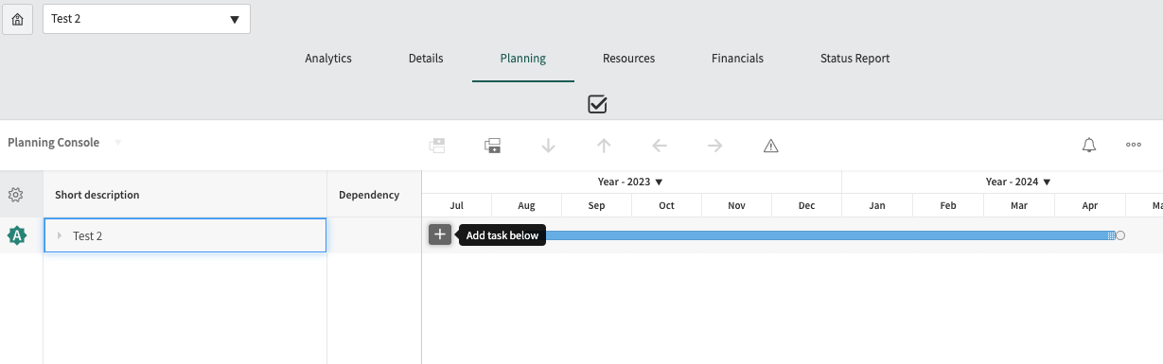
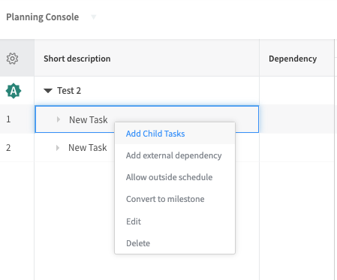
Planning: Creating WBS from the Planning Console
The Planning Console is a centralized interface for the Project Management application. It gives project managers a comprehensive view of all aspects of a project, project tasks that appear in a work breakdown structure (WBS) list and the project Gantt chart.
You can create WBS tasks on the Planning Console by clicking on its Related Link on the project record.
This opens the Planning Console where project tasks may be created. Click on the ‘+’ icon to add a task. You may edit the project task here or on the Project Tasks Related List.
Right click in the short description of the task to edit the label, add child task, etc. Use Convert to Milestone to create Milestones for the Project.
1
2
3

Slide 35
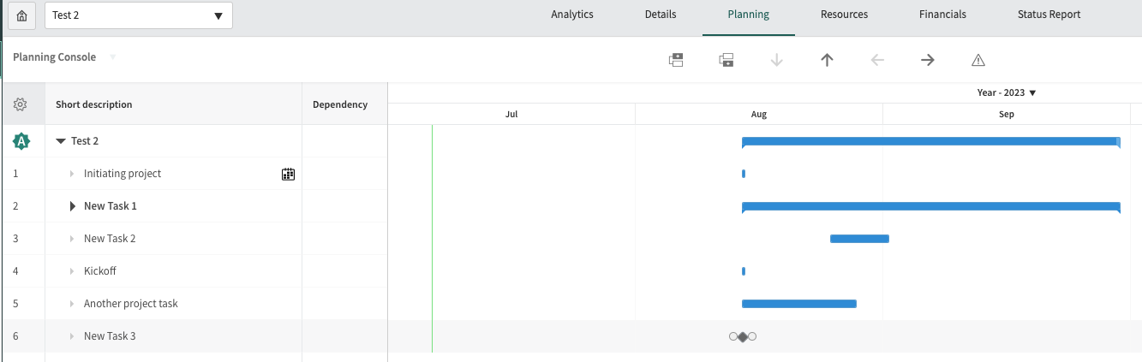
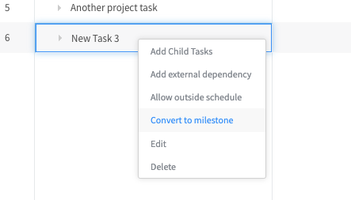
Planning: Creating WBS from the Planning Console
Automatic project icon. This means the project was created automatically from an approved demand. Any changes to dates, duration or relationships of a project task automatically updates all the tasks in the entire project, including the project record.
Select a project task.
Use the ‘Add Task Above’ and ‘Add Task Below’ to create a new task that should occur before or after the selected task.
Use the up and down arrow icons to move a selected task up or down in the hierarchy. Use the left and right arrow icons to indent or unindent a selected task to create a child/nesting task (right arrow) or remove a child/nesting task (left arrow).
Critical path. the critical path is highlighted in red on the Gantt chart to differentiate critical path tasks from standard tasks in blue. Use the critical path to determine which tasks are driving the finish date. If schedule adjustments are necessary, consider making resource or other changes to those tasks on the critical path.
Creating milestones. Right click on the task and select ‘Convert to milestone’. The milestone will show as a diamond icon on the Gantt chart.
3
4
5
1
2
6

Slide 36
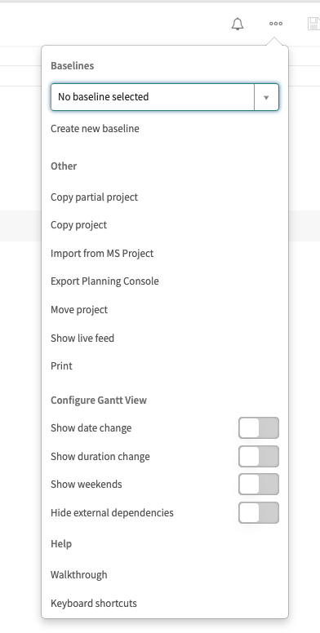
Planning: Planning Console – More Actions
More actions icon.
Baselines. Select a baseline to compare against your project or create a new baseline.
These functions will not likely be used with the OITS process. To be familiar with this advanced functionality ServiceNow offers.
Copy partial project: copy specific project tasks (partial project) or
Copy project:
Import from MS Project: If configured, you may import MS Project into ServiceNow.
Export Planning Console: creates an Excel document with all project tasks and milestones.
Move project: move project to a new start date and moves all cost plans, benefit plans, project tasks and subprojects relative to the start date of the project.
These are more advanced functions to change the view on the Gantt chart.
1
2
3
4

Slide 37
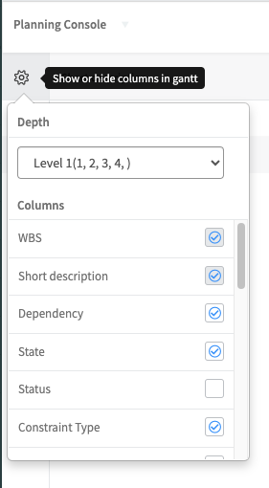
Planning: Planning Console – Show/Hide Columns
Gear icon: allows you to show and hide columns in Gantt chart.
Depth: has two levels to show project tasks or project tasks with related child tasks.
Columns: Allows you to personalize your Planning Console view.
WBS and Short description columns cannot be removed (read-only)
Click on the checkbox for columns you want to view. Uncheck columns you don’t want to view.
1
2
3

Slide 38
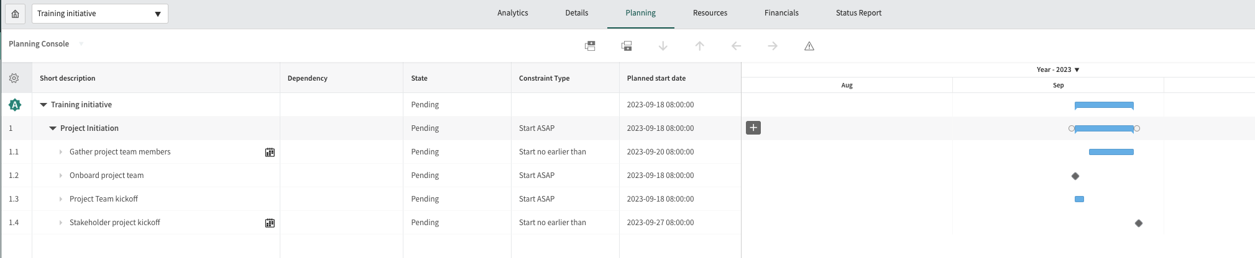
Planning: Planning Console List & Gantt Views
The Planning Console will allow you to view a list view as well as the Gantt chart at the same time.
Locate the vertical line on the Planning Console and drag it left or right.
List view of project tasks.
Gantt chart view.
1
2
3

Slide 39
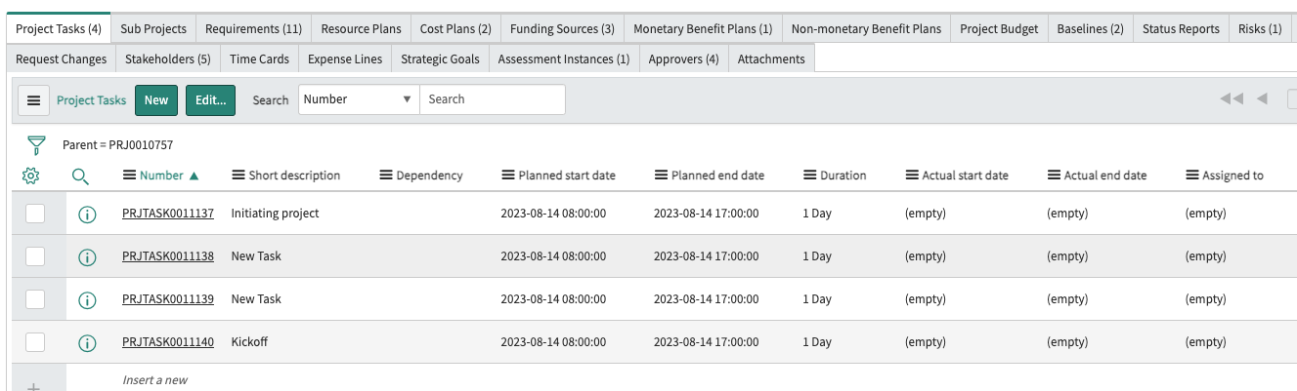
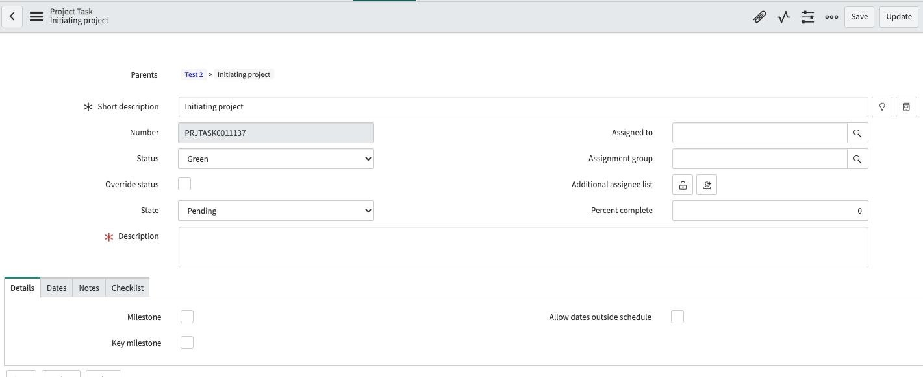
Planning: Creating WBS from Project Tasks Related List
Navigate to the Project Tasks Related List and click on the ‘New’ button to create WBS tasks.
Click on the project number to open the task record to edit it.
1
2

Slide 40
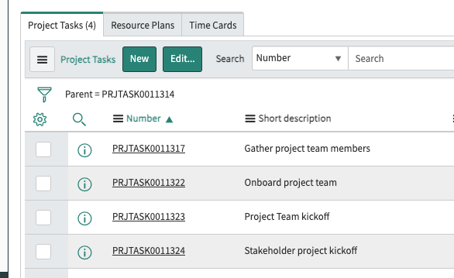
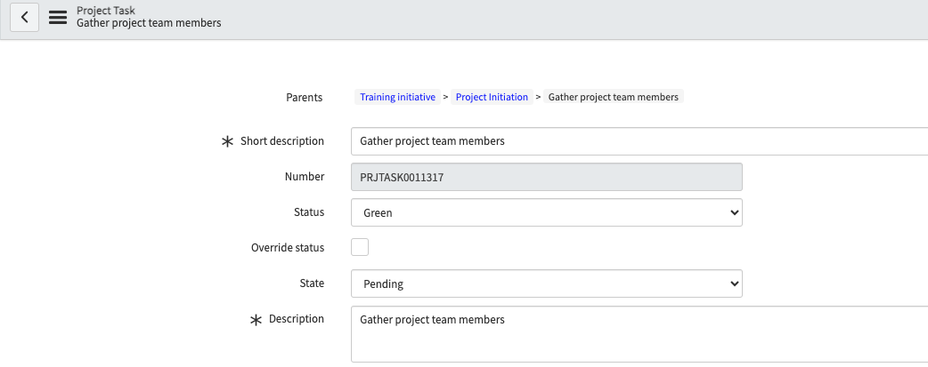
Planning: Creating Child Tasks
Navigate to the Project Tasks Related List on the parent Project Task record.
Click on the ‘New’ button to create a new project task.
To edit a task, double click on the record number in the related list.
Once a child task is created, at the top of the record the parent records are shown. In the example below:
Training Initiative = Project record
Project Initiation = Parent Project Task record
Gather project team members = Child Project Task record
1
2

Slide 41
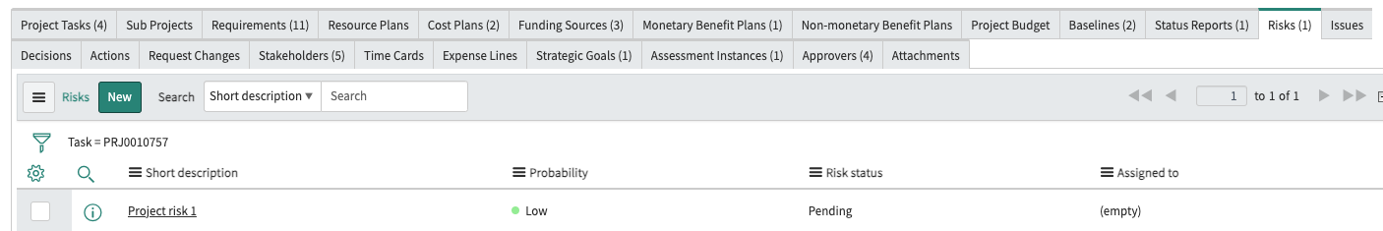
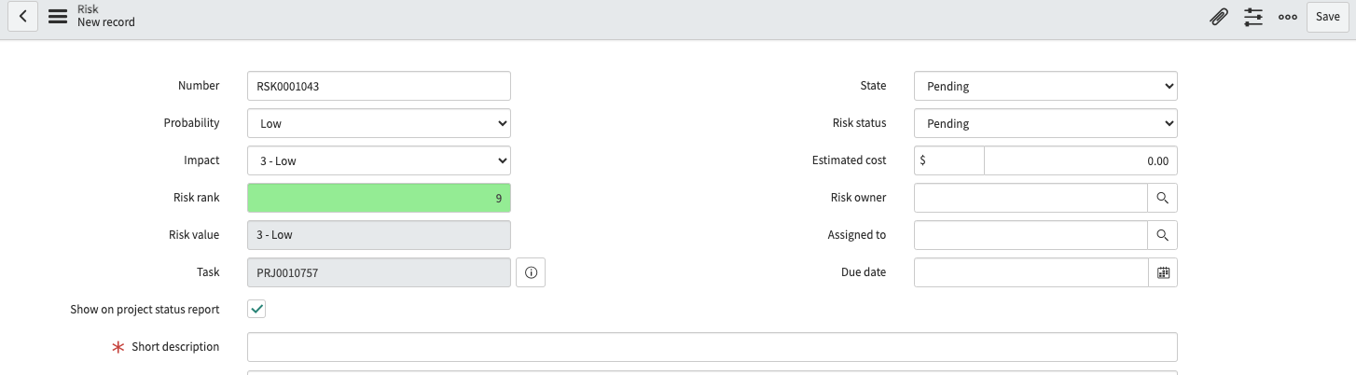
Planning: Project Risks
Each project must have at least one Risk documented. Navigate to the Risks Related List. Click on the ‘New’ button.
The ‘Show on project status report’ field is checked so the Risk shows on the status report. DO NOT uncheck this box.
Fill out the details of the Risk and click on the ‘Save’ button.
1
1
2

Slide 42
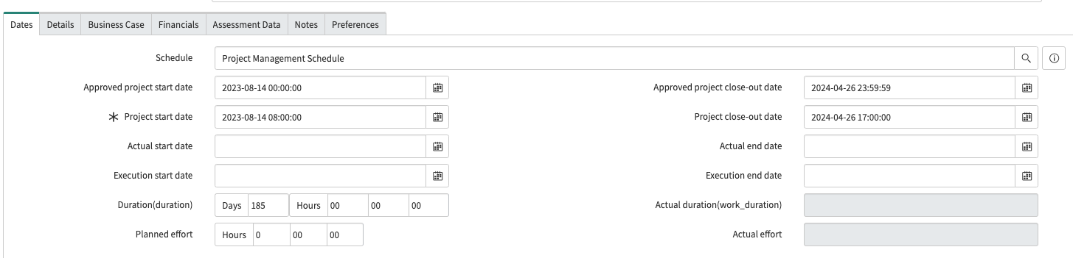
Planning: Execution Start and End Dates
On the Dates tab, the Execution start date and Execution end date fields must be populated to move to the next phase.
The Execution start date is when you believe the project will be executed. It is populated when the project moves to the Executing phase by CITO approval.
The Execution end date is when you believe project execution will be complete. It is populated when the project moves out of the Executing phase.
Other dates on the form are:
Approved project start date: Latest CITO approved start date for QSR. Will need to be updated if the project is Recast.
Approved project close-out date: Latest CITO approved close date QSR. Will need to be updated if the project is Recast.
Project start date: Populates from the approved demand. Estimated or Planned Start.
Project close-out date: Populates from the approved demand. Estimated or Planned End.
Actual start date: Date is populated by project manager when project work actually begins.
Actual end date: Date is populated by project manager when project work is actually completed.
3
1
2

Slide 43
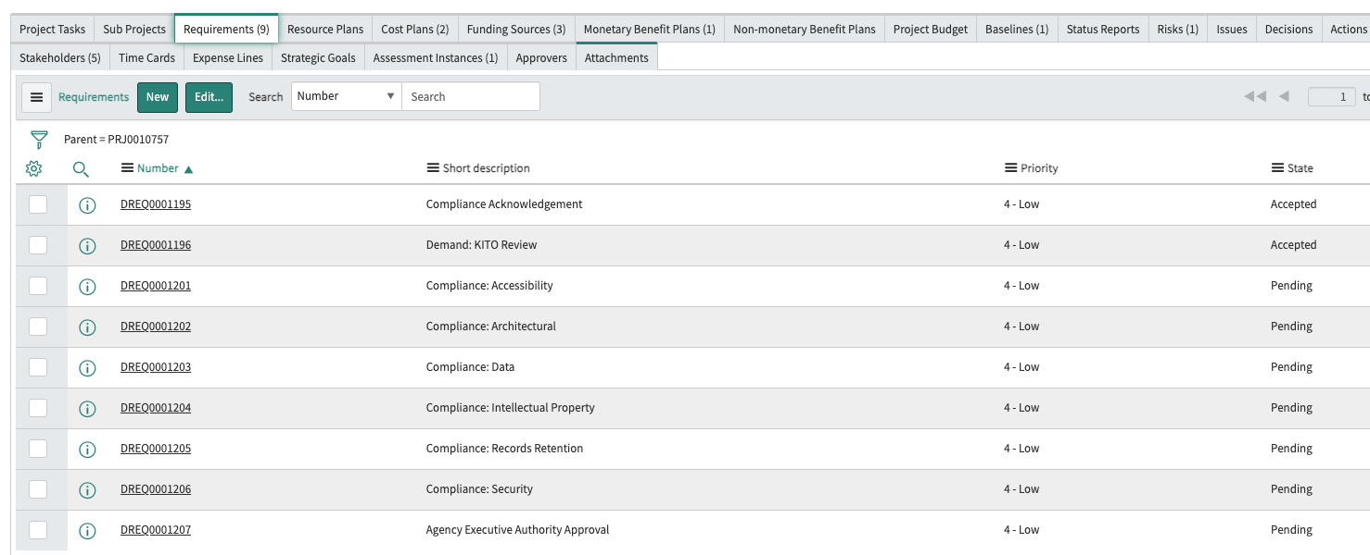
Planning: Compliance Requirements
On the Requirements Related List, there are six Compliance Requirements to be completed before the Agency Executive Authority may review the project. These are:
Accessibility, Architectural, Data, Intellectual Property, Record Retention and Security
Project compliance acceptance and approval will be completed by designated approvers or in coordination with the project manager if they do not have access in ServiceNow.
NOTE: The Compliance Acknowledgement and KITO Review (if necessary) have been completed in the demand workflow and are populated in the project record.

Slide 44
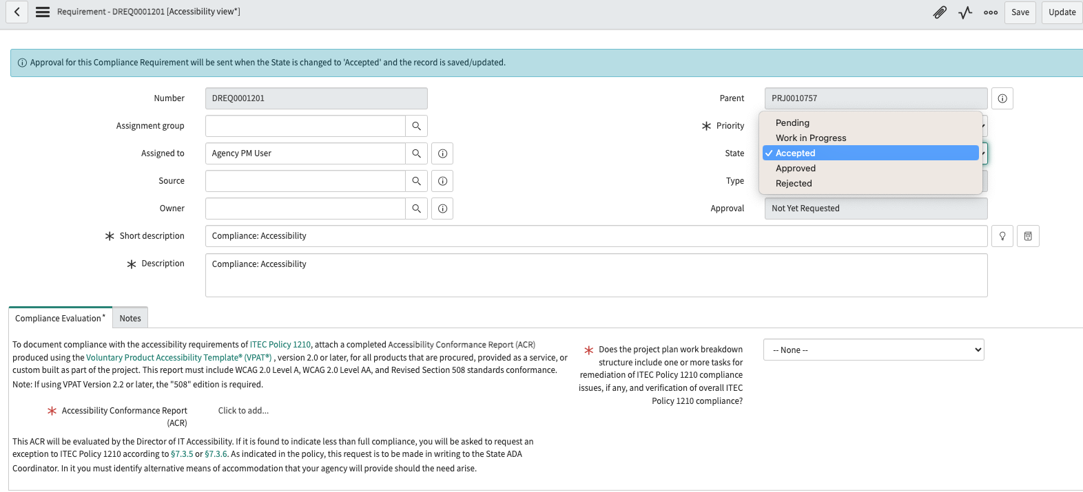
Planning: Accessibility Compliance Requirement
Navigate to the Requirements Related List and click on the requirement number for ‘Compliance: Accessibility’.
On the Compliance Evaluation tab, attach the Accessibility Conformance Report (ACR).
Select ‘Yes’ or ‘No’ on the project plan work breakdown structure field for overall ITEC Policy 1210 compliance.
Update the State field to Accepted, not Approved.
Click on the ‘Update’ button to save the record and return to the project record.
4
3
2
1

Slide 45
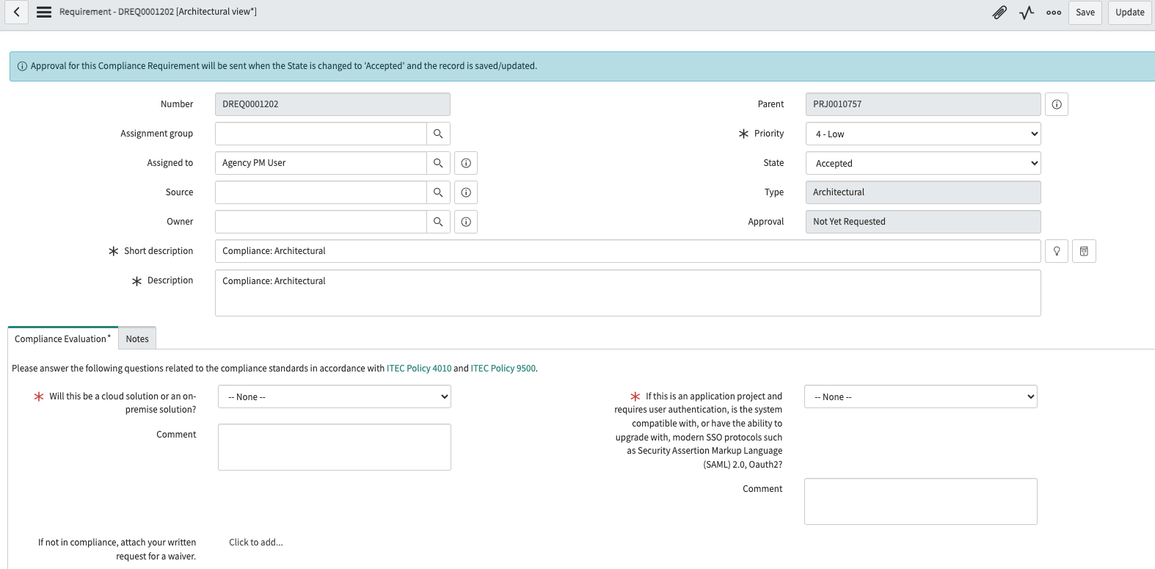
Planning: Architectural Compliance Requirement
Navigate to the Requirements Related List and click on the requirement number for ‘Compliance: Architectural’.
On the Compliance Evaluation tab, describe if the project will have a cloud or on-premise solution.
If the Architecture will not be in compliance with ITEC Policy 4010 and/or ITEC Policy 9500, attach a request for a waiver.
If the project requires user authentication or can use modern SSO protocols, select ‘Yes’, ‘No’ or ‘Not applicable’.
Update the State field to Accepted, not Approved.
Click on the ‘Update’ button to save the record and return to the project record.
5
4
1
3
2

Slide 46
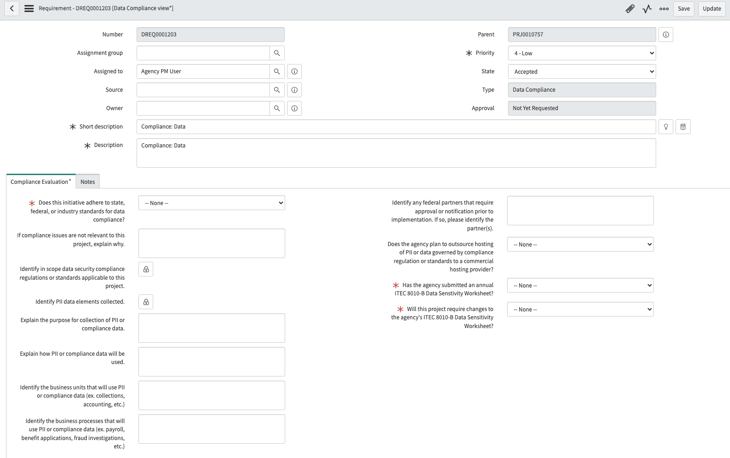
Planning: Data Compliance Requirement
Navigate to the Requirements Related List and click on the requirement number for ‘Compliance: Data’.
On the Compliance Evaluation tab, complete the required fields (marked with a red asterisk) at a minimum.
Update the State field to Accepted, not Approved.
Click on the ‘Update’ button to save the record and return to the project record.
3
2
1

Slide 47
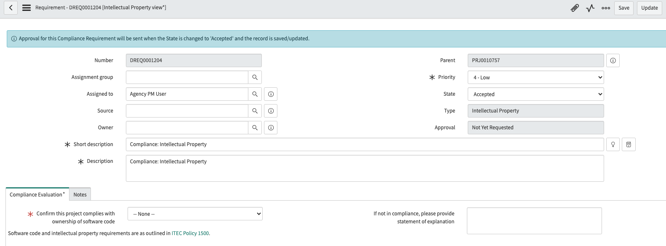
Planning: Intellectual Property Compliance Requirement
Navigate to the Requirements Related List and click on the requirement number for ‘Compliance: Intellectual Property’.
On the Compliance Evaluation tab, describe if the project complies with ownership of software code per ITEC Policy 1500.
Update the State field to Accepted, not Approved.
Click on the ‘Update’ button to save the record and return to the project record.
3
2
1

Slide 48
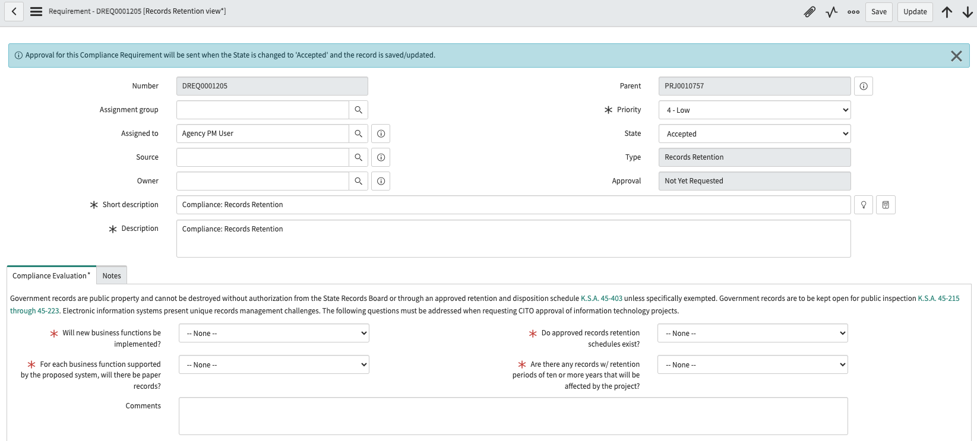
Planning: Records Retention Compliance Requirement
Navigate to the Requirements Related List and click on the requirement number for ‘Compliance: Records Retention’.
On the Compliance Evaluation tab, complete the required fields (marked with a red asterisk).
Update the State field to Accepted, not Approved.
Click on the ‘Update’ button to save the record and return to the project record.
3
2
1

Slide 49
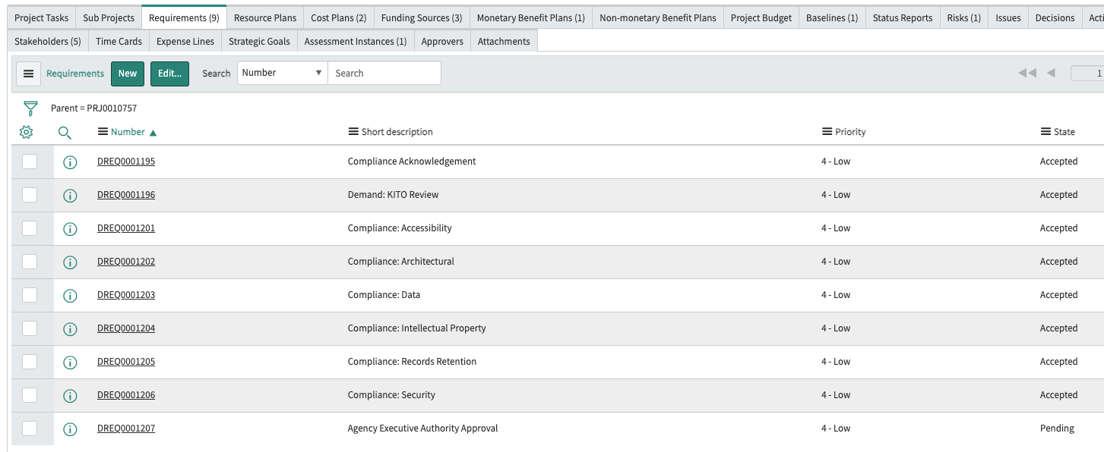
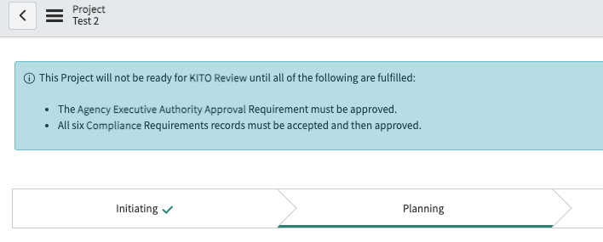
Planning: Compliance Requirements Review
Once the Compliance Requirements have been completed by the project manager (state = Accepted), the blue banner message on the project record prompts the project manager that the Compliance Requirements must be approved. These approvals will be done by the designated approvers.
On the project record, the Requirements tab shows the Compliance Requirements in the ‘Accepted’ state and ready for review and approval.
2
1

Slide 50




Planning: Agency Executive Authority Approval
If the project’s Total Planned Cost is more than $10M, Agency Executive Authority approval is required.
Navigate to the Requirements Related List and open the ‘Agency Executive Authority Approval’ record.
When the Agency Executive Authority is ready to review the project, the project manager will click on the ‘Request Agency Approval’ button. The Approval field updates to ‘Requested’.
3. The Agency Executive Authority may approve or reject the project review from the notification.
NOTE: Do not make any changes to the project record until the Agency Executive Authority review is completed.
When the Agency EA approves the project, it triggers a Requirement record for KITO Review.
3
1
2

Slide 51



Planning: Compliance Requirement Approval by KITO
If KITO staff approve the project Compliance Requirement, they will approve the approval record located on the Approvers Related List. Update the State field to ‘Approved’
Navigate to the Approvers Related List. Right click on the State field and select ‘Approve’ to update the approval request record.
Click on the ‘Save’ button.
Use the up and down arrows to easily move from one Requirement record to another without closing the record.
When the Requirement is approved, a notification is sent to the project manager.
3
4
1
2
5

Slide 52



Planning: Compliance Requirement Rejection
If any designated approvers require additional information/clarification, they will reject the requirement. Approvers must populate the Comments field to explain what information is requested.
Navigate to the Approvers Related List. Right click on the State field and select ‘Reject’ to update the approval request record.
Click on the ‘Reject’ button to change the State to ‘Rejected’.
The Requirement record’s blue banner message shows the rejected approval.
NOTE: The Requirements record is set back to the ‘Pending’ state. The project manager must update the record and update the State field to ‘Accepted’ signaling to designated approvers that the Compliance Requirement is ready for an additional review.
1
3
2
4

Slide 53


Planning: KITO Review
The Agency Executive Authority approval triggers KITO Review. NOTE: Do not make any changes to the project record until the KITO review is completed.
On the project record a new Requirement is generated for KITO Review.
1
2

Slide 54


Planning: KITO Review - Acceptance
If KITO staff accept the project Compliance Requirement, they will change the State field to ‘Accepted’. Click on the ‘Save’ button.
When KITO Review is accepted, the project requires CITO approval.
When KITO Review is completed, a notification is sent to the project manager.
1
2

Slide 55


Planning: KITO Review - Rejection
If KITO staff require additional information/clarification, they will reject the requirement. Update the State field to ‘Rejected’ and populate the Work notes field (will be required) to explain what information is requested. Click on the ‘Save’ button.
The project manager will receive a notification asking for corrections, clarification and/or additional information.
NOTE: The Requirements record is set back to the ‘Pending’ state. The project manager must update the record and update the State field to ‘Accepted’ signaling to KITO the Compliance Requirement is ready for an additional review.
2
1

Slide 56


Planning: CITO Approval
Following KITO’s acceptance of the project, CITO approval is required. NOTE: Do not make any changes to the project record until the CITO review is completed.
CITO will receive a notification to review and approve the project.
The project automatically advances to the Executing phase with CITO approval. The Execution start date on the Dates tab will populate with CITO approval.
1
2

Slide 57



Planning: CITO Rejection
If CITO requires additional information/clarification, they will reject the approval record request. When clicking on the ‘Reject’ button, the comments field will explain what additional information is requested. Click on the ‘Save’ button.
KITO and the project manager will receive a notification informing them of the CITO request for additional information. KITO will coordinate with CITO and provide the clarification and/or additional information.
A new KITO Review Requirements record is created by the workflow. When KITO accepts the review, CITO will receive a new approval request for the project.
1
2
3

Slide 58
Executing Phase

Slide 59
Project Management: Process Flow
Initiating
Planning
Executing
Delivering
Closing
Assign Project Manager
Verify information from approved Demand (e.g., Cost Plans, Benefit Plans, Stakeholders, Requirements)
Baseline from approved Demand created
Define Schedule(Build WBS with Milestones)
Identify Project Team
Project Risk Assessment
Compliance Requirements
Agency Executive Authority Requirement
Baseline Project
Begin Work (Project begins with CITO approval)
Update Tasks
Manage Communications
Manage Risks,
Issues
Status Reporting for Quarterly Status Reports
Testing
Update tasks and milestones
Training
Operational documentation
Organizational change
Post-Implementation Evaluation Review – PIER Report
Close Project

Slide 60
Executing: Update Project Data
Key Activities:
Status Reporting for QSR
Keeping project tasks updated
Keeping costs and benefits updated
Documenting Risks and Issues
Recast Requests
Other tasks
Updating stakeholders
Reporting and tracking

Slide 61


Executing: Submitting Status Reports
1. Click on the ‘Status Report’ Related Link to create a status report.
2. You land on the Status Report tab of the Planning Console.
3. Click on the ‘Create new’ button to create a new report.
1
2
3

Slide 62

Creating a Status Report – Overall Status tab
Create your status reports as close to the quarterly report suspense date as possible for KITO to complete the Quarterly Status Report.
Status Date: It will populate to current date.
Overall Status: Provide updates for the Executive Summary, Comments, Last Week’s Achievements and Key Activities planned fields.
Overall health: Reflects information from most recent status entered by the project manager for the project.
1
2
3

Slide 63


Creating a Status Report – Schedule tab
Planned End: This reflects the planned end date even though it isn’t populated in this field. It is given in the main body of the record.
Project Length in Days: This field may be manually updated by the project manager. This is business days but doesn’t include holidays. From the Dates tab, you may enter the number of days shown in the Duration field.
Actual End: This reflects the actual end date even though it isn’t populated in this field. It is given in the main body of the record.
Comments on Schedule: Enter any updates on schedule (e.g., ahead of schedule, behind schedule or on target).
1
2
3
4

Slide 64

Creating a Status Report – Cost tab
Actual Execution Cost to Date: Project managers will manually populate this data.
Planned Execution Project Cost: This reflects the financial data entered on the cost and benefit plans. Total Planned Cost on Financials tab.
Comments on Cost: Enter any updates on project cost (e.g., under budget, over budget or on target).
1
2
3

Slide 65

Creating a Status Report – Resources tab
Actual Execution Work Hours: Project managers will manually populate this data.
Actual Execution Work Variance: Project managers will manually populate this data.
Comments on Resources: Enter any updates on resources (e.g., committed resources are sufficient or at risk of moving to another project).
1
2
3

Slide 66

Creating a Status Report – Scope tab
Actual Execution Deliverables Completed: Project managers will manually populate this data.
Actual Execution Tasks Completed: Populates from Project Tasks completed.
Planned Execution Deliverables Completed: Project managers will manually populate this data.
Planned Execution Tasks Completed: Populated from total Project Tasks for the project.
Comments on Scope: Enter any comments on scope (e.g., potential project scope creep).
1
2
4
3
5

Slide 67


Submitting Your Status Report
When you have completed your status report, click on the ‘Submit’ button.
The Status Reports Related List will populate with the status report. You may access the record here by clicking on the status report number.
It’s possible to edit the report here, although once it is submitted for the quarterly status report, it should not be.
1
2
3

Slide 68


Sharing Status Reports
On the Planning Console’s Status Report tab, navigate to the printer icon next to the ‘Create new’ button.
You may print the report or save it as a PDF document.
1
2

Slide 69

Viewing Status Reports
On the Planning Console’s Status Report tab, you may select the status report you want to view.
Scroll down the page to see the full report.

Slide 70


Viewing Status Reports
The Most Recent Status Report field on the project record will populate with the latest status report.
The preview icon will show a preview of the status report and to open the status report from here, click on the ‘Open Record’ button.

Slide 71
Recast Procedure Overview
If the Project is over budget or behind schedule, submit a Recast request.
Before recasting the project, take a baseline “Naming convention” – Pre-Recast Baseline.
Project Manager should update costs, benefits, schedule, etc.
Create a Change Request record to submit the Recast request. Don’t make changes to the project record while the Recast Request is being reviewed and approved.
The Change Request goes through KITO review and Executive Authority and CITO approval processes
Upon Approval, a new baseline will be automatically created.
New baseline determines overages for cost and schedule going forward
New baseline determines future KITO Oversight Fees

Slide 72




Establish Pre-Recast Baseline
Navigate to the Baselines Related List and click on the ‘Create Baseline’ button or…
Click on the ‘Create Baseline’ Related Link.
Name your baseline per your naming convention. NOTE: Use this same exact name for the Change Request record title field.
A Schedule and Financial Baseline will be created. Do not uncheck these fields. Click the ‘Save’ button to create the baseline.
1
3
4
2

Slide 73



Pre-Recast Baseline
When you have completed creating the baseline, make the needed schedule change(s) in the project record on the Dates tab for the Approved project start date or Approved project close-out date as well as update cost plan information.
Navigate to the Planning Console, click on the More actions icon to view the baseline.
You will see a gray area showing the change in the baseline selected compared against the project timeline.
1
2
4
3

Slide 74


Create Request Change to Recast a Project
If a project needs to be recast, navigate to the Request Changes Related List. This may be requested in any project phase, although it is most likely in the Delivering phase. Click on the ‘New’ button.
Select ‘Recast’ in the Category field.
Use the SAME name of your Recast Baseline for the Change Request title to ensure status reports match these two records to each other.
Click on the ‘Save’ button.
NOTE: The KITO Approval and CITO Approval fields appear.
1
4
2
3

Slide 75


Recast a Project – Request Approval
When you are ready to request your project to be recast, click on the ‘Request Approval’ button.
On the Approvers Related List, the KITO approvers are requested to review and accept this task.
1
2

Slide 76


Recast a Project – KITO Approval
KITO staff will receive a notification to review the Recast request.
When KITO approves the request, the KITO Approval field will update to ‘Approved’. The CITO Approval field shows as ‘Requested’.
On the Request Change record, the Approvers Related List shows KITO approval.
1
2

Slide 77


Recast a Project – KITO Rejection
If KITO staff require additional information, they will reject the approval request.
The Request Change record state will update to Closed Incomplete.
The project manager will receive a notification regarding the KITO information requested.
To submit the additional information, the project manager must create a new Change Request record for KITO Review.
1
3
2

Slide 78


Recast a Project – CITO Approval
CITO will receive a notification to review and approve the Recast request.
When CITO approves the request, the CITO Approval field will update to from ‘Requested’ to ‘Approved’. The record state updates to Closed Complete.
On the Request Change record, the Approvers Related List shows CITO approval.
1
2

Slide 79

Recast a Project – CITO Rejection
CITO will receive a notification to review and approve the Recast request.
If CITO rejects the request, the CITO Approval field will update to from ‘Requested’ to ‘Rejected’.
If the project requires any further Recast requests, the project manager should create a new Change Request record.

Slide 80
Recast Project Request Approved
Once a Recast request is approved by CITO, the project manager should update the Approved project start date and Approved project close-out date on the Dates tab.
If the request was due for budget reasons, update the cost plans.

Slide 81
Delivering Phase

Slide 82


Move to Delivering
When all the project tasks are completed, the project is ready to move to the Delivering phase. Click on the ‘Deliver’ button.
When the project moves to the Delivering phase, the ‘Close’ button is available.

Slide 83
Project Management: Process Flow
Initiating
Pending
Executing
Delivering
Closing
Assign Project Manager
Verify information from approved Demand (e.g., Cost Plans, Benefit Plans, Stakeholders, Requirements)
Baseline from approved Demand created
Define Schedule(Build WBS with Milestones)
Identify Project Team
Project Risk Assessment
Compliance Requirements
Agency Executive Authority Requirement
Baseline Project
Begin Work (Project begins with CITO approval)
Update Tasks
Manage Communications
Manage Risks,
Issues
Status Reporting for Quarterly Status Reports
Testing
Update tasks and milestones
Training
Operational documentation
Organizational change
Post-Implementation Evaluation Review – PIER Report
Close Project

Slide 84

Delivering: Prepare to Close Project
Delivering Phase is not used at this time
Prepare to close project
Close procedure
Attach PIER to project record
Close Project
Task states – Project Tasks must be completed (e.g., Work In Progress, Pending states), these tasks will automatically close when the project record State is updated to Closed Complete.

Slide 85
Delivering:
When project is ready to be closed, click on the Close button.

Slide 86
Closing Phase

Slide 87
Project Management: Process Flow
Initiating
Planning
Executing
Delivering
Closing
Assign Project Manager
Verify information from approved Demand (e.g., Cost Plans, Benefit Plans, Stakeholders, Requirements)
Baseline from approved Demand created
Define Schedule(Build WBS with Milestones)
Identify Project Team
Project Risk Assessment
Compliance Requirements
Agency Executive Authority Requirement
Baseline Project
Begin Work (Project begins with CITO approval)
Update Tasks
Manage Communications
Manage Risks,
Issues
Status Reporting for Quarterly Status Reports
Testing
Update tasks and milestones
Training
Operational documentation
Organizational change
Post-Implementation Evaluation Review – PIER Report
Close Project

Slide 88
Closing: Completed Project
When all project deliverables have been completed, the project manager clicks on the ‘Close’ button.
The Post-Implementation Evaluation Review (PIER) Report must be completed by the project manager.

Slide 89
Project Dashboards

Slide 90


Financial Workbench
On the project record, click on the Planning Console Related Link.
Click on ‘Financials’ to access the Financial Workbench.
This functionality is available in every project state.
2
1

Slide 91

Financial Workbench
The Financials Summary shows an overview of the costs involved with the project. Cost Plans may be viewed when you click on the ‘Cost Plans’ tab.

Slide 92

Financial Workbench
The Financials Summary shows an overview of the costs involved with the project. Monetary Benefit Plans may be viewed when you click on the ‘Monetary Benefit Plans’ tab.

Slide 93



Investment Portal
Completing projects and demand on time within budget is a challenge. The Investment Portal gives you a comprehensive view of projects and demand financials, deadlines and other important metrics that makes project and demand management more efficient.
2
Navigate to Project > Investment Portal.
Click on the ‘New’ button.
Select ‘Demands/Projects’ in Type field. Set your conditions and click on the ‘Create’ button.
3
1

Slide 94



Investment Portal
Overview: A high-level summary of your projects and demands.
Timeline: Key milestones in a Gantt view. The information in the grid is based on the project and demand form fields.
Financials: A detailed breakdown of project and demand costs in yearly, monthly and quarterly formats, and based on cost plans associated to your projects and demands. This tab is displayed only to users with the it_project_manager role.
1
2
3

Slide 95
Key Terms

Slide 96
Key Terms – Review / Approvals
Key Term | Definition
Executive Authority Approval | Reviews project in Planning phase, required to progress to Executing phase.
CITO Approval | CITO reviews and approves project and Recast requests. Required to move project to Executing state.
KITO Review | KITO reviews reportable projects prior to CITO review as well as Recast request prior to CITO review/approval.
KITO Reportable | An IT Project that requires KITO oversight.

Slide 97
Key Terms - Financials
Key Term | Definition
Budget | An estimated amount of money for a specific fiscal period for operating and capital expenses
Benefit Plan (BP) | Captures the potential benefits, both Hard and Soft, and is accrued when the project is executed.
Cost Plan (CP) | Capture the costs for projects/demands, broken out by unit cost, of a cost type, for a fiscal period. Note: Cost plans are automatically created for resource plans that are associated to projects and project tasks.
Funding Sources | Source of IT project funding (e.g., Federal, State, Fees).
Average Annual Ongoing Cost of Ownership | Estimated annual ongoing cost of ownership of executed IT project.
Estimated life/length of Commitment (in years) | The number of years the IT solution is expected to be in place.
Capital expense | Organization’s major, long-term expenses.
Operational expense | Organization’s day-to-day expenses.
Quarterly Oversight Fee | Fee charged by KITO to oversee reportable IT projects.

Slide 98
Key Terms - Dates
Key Term | Definition
Approved project start date | The latest CITO approved start date for Quarterly Status Report (QSR).
Approved project close-out date | The latest CITO approved close date for Quarterly Status Reports (QSR).
Estimated project start date | Estimated or planned project start date.
Estimated project close-out date | Estimated or planned project end date.
Estimated execution start date | Estimated date when the proposed IT project will be executed (in Executing state in Project workflow).
Estimated execution end date | Estimated date when the proposed IT project execution phase is complete (in Delivering state in Project workflow).
Baseline | A baseline is a set of stored values or a snapshot in time, for when values have been formally defined agreed on. Values can include scope, schedule and cost. Demands can have a Baseline, as well as Projects.

Slide 99
Key Terms – Details
Key Term | Definition
Initiative name | The name of the IT project.
Investment type | Defines if IT project is infrastructure or non-infrastructure related.
Business case | The reason / justification for an IT project.
Requirement | An extra item that must be present or an extra action item that must be finished before a project request closes.
Project Task | A unit of work, created within the project or the Planning Console, to create the WBS (Work Breakdown Structure) to implement the project.
Change Request | Record used to request a project recast.
RIDAC | Acronym for Risks, Issues, Decisions, Actions and Changes Note: Changes for Projects are called ‘Project Change Requests’, not to be confused with Change Requests.
Status Reports | Updates regarding project progress (e.g., schedule and financials).

Slide 100
Key Terms - Assessments
Key Term | Definition
Assessments | Project Assessment is a questionnaire sent to Project Managers that focus on two categories: Risk and Strategic Alignment
Score | Calculated based on individual risk assessment scores.
Scorecard | A visual breakdown on performance of an assessable record based on assessment results. Use scorecards to view various data summaries for one assessable record and to compare the ratings with other assessable records.
Project Risk Assessment | Risk assessment all IT projects that must be completed.

Slide 101
Key Terms – Users and Process
Key Term | Definition
Stakeholder | A person affected by the demand or who has interest in the demand.
Project Manager | The person who will manage the OITS IT project.
Collaborators | People selected who can edit the demand while in draft.
Project | A temporary endeavor with a defined scope of work and defined start and end points to create a unique product, service or result that may be tangible or intangible.
Project Management | The application of knowledge, skills, tools and techniquest to project activities to meet the requirements of projects of all sizes.
Strategic Goals | Goals associated with the selected strategy. A project can fulfill multiple goals. Note: If a strategy is not selected, then all goals are displayed in the choice list.

Slide 102
Required Information – By State
Initiating | Planning | Executing | Delivering | Closing
Project Manager | Project Risk Assessment | Update Project Tasks | Update/Close Project Tasks | PIER Report
 | Compliance Requirement Approval | Status Reports
 | Risk record | Recast Request(s)
 | Execution start and end dates
 | Creation of WBS (project tasks)
 | Agency EA Approval
 | KITO Acceptance
 | CITO Approval

Slide 103

Project Form: Header
Process Flow Indicator: Highlights the current state of the project. Checks off the states that a project has passed through. Leaves blank the states that have been skipped.
Initiative Name: Project name.
Initiative Acronym: Project agency initiative acronym.
Project manager: Name of project manager.
Status: Updates based on status reports.
Percent complete: Updates based on status reports.
Description: Details about the project
Planning button: Moves the project to the next state (Planning state).
8
1
2
3
6
4
5
7

Slide 104

Project Form: Dates Tab
Schedule: Defaults to Project Management Schedule.
Approved project start date: Latest CITO approved start date for QSR. Will need to be updated if the project is Recast.
Approved project close-out date: Latest CITO approved close date QSR. Will need to be updated if the project is Recast.
Project start date: Populates from the approved demand. Estimated or Planned Start.
Project close-out date: Populates from the approved demand. Estimated or Planned End.
Actual start date: Date is populated by project manager when project work actually begins.
Actual end date: Date populated by project manager when project work is actually completed.
Execution start date: The date when the Project moves to the Executing state, following CITO approval.
Execution end Date: The date when the Project moves to the Delivering state.
NOTE: Date field coloration documents thresholds and are visual indicators. They do not have an impact on the approval processes.
1
2
3
4
5
6
7
8
9

Slide 105

Project Form: Details Tab
Investment Type: Populates from the approved demand (Infrastructure or Non-infrastructure choice affects Oversight Fee Rate).
Execution Type: Defaults to Waterfall, can be Hybrid or Agile.
Demand: The approved demand that created the project.
Agency: Populates from the approved demand. The agency presenting the initiative.
Impacted Agencies: Populates from the approved demand. Agencies who are not sponsoring the initiative but are impacted by it.
4
5
1
2
3

Slide 106

Project Form: Business Case Tab
Business case: Populates from the approved demand. The justification for the initiative.
Minus/Plus: Will expand the text field to allow additional text to be added.
1
2

Slide 107

Project Form: Financials Tab
Total planned cost (minus Quarterly Oversight Fee): Populates from the approved demand, subtracts Quarterly Oversight Fee.
Financials Populated from the Cost Plans. Data transfers from the Demand.
Average Annual Ongoing Cost of Ownership: Populates from the approved demand. Can be updated with detailed planning.
Estimated life/length of Commitment (in years): Populates from the approved demand. Can be updated with detailed planning.
1
3
2
4

Slide 108

Project Form: Assessment Data Tab
KITO Reportable: Populates from the approved demand.
Overall Project Risk Score: Populates based on Project Risk Assessment scores (e.g., Strategic, Financial, Project Management, Technology, Change Management / Operational Risk).
Risk scores: Project Risk Assessment score.
Business Risk Assessment Data: Populates from the approved demand.
NOTE: Red and Yellow designations will NOT affect the next steps in the workflow, just visual indicators.
1
2
3
4

Slide 109


Project Form: Notes, Preference Tabs
Watch list: Groups and users who can view additional comments. You can add users to the watch list by clicking on the lock icon. Close the unlocked icon to save users.
Work notes list: Groups and users who can view work notes. You can add users to the work notes list by clicking on the lock icon. Close the unlocked icon to save users.
Work notes: Captures the transactional history for the project including project state changes.
Show on Program Status Report: Shows on project status report (click on Status Report Related Link)
1
2
3
4

Slide 110



Project Form: Filtering Notes
On the Notes tab, you may filter the notes for specific information.
Funnel icon: Click on the icon to view the Filter Activity fields.
Default view: The Filter Activity shows all the information in the notes. Uncheck ‘All’ on the filter to select the filters you want.
Filtered view: Scroll through the available filters and check the boxes of the ones you want.
Filtered Activities view: Once you create a filtered view, any demand you view will use this filter.
NOTE: This filter will be applied to any demand you view. It does not affect how others view the same demand.
1
2
3
4

Slide 111

Project Related Links
Planning Console: Opens the Planning Console to easily view/edit project tasks and milestones.
View RIDAC: View Risks, Issues, Decisions, Actions and Change Requests.
Status Report: Create and/or view project status reports on the Status Reports tab on the Planning Console.
Create Baseline: Create a new project baseline. Will be added to Baselines Related List and can be viewed and compared on the Financials tab of the Planning Console.

Slide 112
Project Related Links
These Out of Box (OOB) Related Links are available on the project record but are being currently not critical for KITO projects.
Calculate Completion Estimates
Move Project
Project Workbench
Save as New Template

Slide 113


Project Related Lists: Project Tasks
Project Tasks are used by the Project Manager to assign tasks. This list is linked to the Planning Console.
Click on the Project Task number to open the task.
Click on ‘New’ to create a Project Task.
Tasks may be assigned to groups or individuals. Add additional assignees by clicking on the lock icon under the Assigned to field.
Milestones are replacing the WPI (Work Product Index) for KITO reporting activities. Check the box to establish the task as a Milestone or Key milestone.
2
1
3
4

Slide 114


Project Related Lists: Nesting Project Tasks
Project Tasks can be nested to create dependencies between related tasks. Nested tasks will be seen on the Planning Console.
On the Project Task record, navigate to the Project Tasks Related List. Click on ‘New’ to create a nested Project Task.
When a nested or child task is saved, above the Short description field you will see the parent records related to it.
Test2 is the project record, New Task 1 is a project task that is the parent record to Nested task which is the nested task.
2
1

Slide 115

Project Related Lists: Task Dates and Cost Plans
When creating project tasks, you may see the following messages in a blue banner:
Unable to calculate IRR: This message means the Internal Rate of Return (IRR) and Net Present Value (NPV) fields on the demand record related to the project are empty. A cost plan for a fiscal year must exist to calculate NPV. New screen shot with this banner message.
Associated cost plan dates have been shifted: Based on the task dates, the related cost plan dates have been changed. This means you must update the cost plans if the project task dates change to keep them in alignment.
1
2
Notes:
Unable to calculate IRR
Conditions for populating NPV and IRR need to be met. A cost plan for a fiscal year must exist to calculate NPV.
IRR is the discount rate that would cause the net present value (NPV) of a project to be 0. So, in order to calculate IRR we need to have Cash flow values with at least one positive value and one negative value.
Cash flow from a cost plan is considered a negative value and cash flow from a benefit plan are considered as a positive value. If, at least, one positive and one negative value exists, then calculate IR.
Resolution
For NPV to be populated, the following condition must be met:
A cost plan must be created that spans a fiscal year.
For IRR to be populated, the following conditions must be met:
Cost plan and/or benefit plan records should be present for at least two Fiscal years
There should be at least one fiscal year with a positive value (Sum of benefit plan breakdown values for the fiscal period is greater than sum of cost plan breakdown values)
There should be at least one fiscal year with a negative value (Sum of cost plan breakdown values for the fiscal period is greater than sum of benefit plan breakdown values)

Slide 116



Project Related Lists: Sub Projects
Sub Projects can be added by the Project Manager to relate projects to each other.
Click on the ‘Edit’ button to add a child project to the project.
Select the project from the Collection list on the left. Use the arrows to add the project. Click on the ‘Save’ button.
The sub project is added to the related list.
NOTE: This will not be used with the current KITO process but is available for use in other situations.
1
2
3

Slide 117

Project Related Lists: Requirements
Requirements from the approved demand are populated.
Click on the Requirement number to open the record to edit it.
Compliance Requirement records requiring action are automatically generated for the project.
Click on ’New’ to create a new Requirement record if needed.
4
2
1
3

Slide 118


Project Related Lists: Cost Plans
Cost Plans are populated from the approved demand and can be updated during detailed planning. Cost Plans populate the Financials Tab.

Slide 119


Project Related Lists: Funding Sources
Funding Sources are populated from the approved demand and can be updated during detailed planning.

Slide 120


Project Related Lists: Benefit Plans
Monetary Benefit Plans and Non-monetary Benefit Plans are populated from the approved demand.

Slide 121



Project Related Lists: Baselines
The Demand to Project Baseline is populated from the approved demand. Additional project baselines, manually or workflow generated, will be listed here.
Click on the ‘View Financial Baseline’ Related Link to view baselines from the Financial Workbench.
The Financial Workbench shows the current planned cost, variance and the demand baseline.
NOTE: Schedule baselines are viewed in the Planning Console.
1
2
3

Slide 122


Project Related Lists: Status Reports
Status Reports are critical for Quarterly Status Reports, and must be updated each quarter for JCIT reporting.
Click on the Status Report number to open the record to edit it.
To create a new status report, click on the ‘New’ button.
2
1

Slide 123

Project Related Lists: Stakeholders
Stakeholders are populated from the approved demand and can be updated during detailed project planning.

Slide 124

Project Related Lists: Creating a new Stakeholder Record
The ‘Create new’ button allows a new person to become a stakeholder.
Navigate to the Stakeholders Related List and click on the ‘Create new’ button.
Populate the Stakeholder Register record.
User: Populate with user’s name.
Key Stakeholder Type: Select stakeholder type.
Approver: Select ‘Yes’.
Save and Update the record.
Return to the project record and view the Stakeholders Related List. The new stakeholder will be populated in the Stakeholder Type desired.
1
2

Slide 125

Project Related Lists: Assigning a Stakeholder to Another Stakeholder Type
The ‘Add existing’ button allows a person who is currently a Stakeholder to become a member of a different Stakeholder group.
Navigate to the Stakeholders Related List. Click on the the ‘Add existing’ button
Update the Key Stakeholder Type field then click on the Save button.
A stakeholder may be a member of multiple groups.
1
2

Slide 126


Project Related Lists: Strategic Goals
A project will inherit strategic goals from the approved demand. Click the ‘Add’ button to add additional project goals or the ‘Remove’ button to remove a goal.
Click on the magnifying glass icon to view available goals to associate with the project.
The Primary goal field will automatically be checked if a goal has not been added to the project. The primary goal may be changed by checking this field for the desired goal.
Save your information and click on the ‘Update’ button to return to the project record.
1
3
2

Slide 127

Project Related Lists: Assessment Instances
This is where the project manager may access the Project Risk Assessment to complete it. Project Risk Assessment is generated when the project is moved to Planning Stage.

Slide 128

Project Related Lists: Approvers
CITO Approvers for move to Executing will be listed here. The result of their decision is found in the State column.

Slide 129

Project Related Lists: Attachments
Attachments may be found here as well as at the top of the project record.

Slide 130
Project Related Lists: Risks
Each project must have at least one Risk documented. Navigate to the Risks Related List. Click on the ‘New’ button.
The ‘Show on project status report’ field is checked so the Risk shows on the status report. DO NOT uncheck this box.
Fill out the details of the Risk and click on the ‘Save’ button.
1
1
2

Slide 131
Project Related Lists: Request Changes
If a project needs to be recast, navigate to the Request Changes Related List. Click on the ‘New’ button.
Select ‘Recast’ in the Category field.
Click on the ‘Save’ button.
NOTE: The KITO Approval and CITO Approval fields appear.
1
3
2

