Slide 1

KARS Training: Demand Management
Kansas Office of Information Technology Services
July 2023

Slide 2
Demand Management

Slide 3
Introductions
Any new attendees?
Name
Role
Demand Management Workflow
What are your Expectations from Demand Management?
Matt Soccio – Cask Sr. Business Advisor
Matt.Soccio@caskllc.com
Theresa Bednarek – Cask Business Consultant
Theresa.Bednarek@caskllc.com

Slide 4

Training Audience
This training is for individuals starting the KITO project intake process. The training may be utilized for any role throughout the Governance, Intake, Screening and Delivery Process to gain an understanding of Demand Management functionality in ServiceNow, and where it fits into and supports the end-to-end process.

Slide 5
Demand Management for KITO Staff
Training Agenda
Basic ServiceNow Navigation
Navigation
Favorites
History
Working with Lists
Demand Management Overview
Demand Management End-to-End Process
Process Objectives
Process Roles
Demand States
Basic Navigation of Demand Form, Demand Related Lists, Service Portal (Demand intake)
Managing a Demand through its Lifecycle
Knowledge Outcomes
How to complete and/or enter a demand form
Managing demand stakeholders for approvals
Business case fundamentals and outcomes
Enter and maintain demand financials (e.g., benefit plans, cost plans, funding sources)
Business Risk Assessment and Business Risk Evaluation surveys
Demand data that transfers to an approved project
Reporting

Slide 6
Why are we doing this at KITO?
  To comply with legislative mandates requiring review and accountability for proposed high value IT projects.
  ServiceNow provides the required workflow to ensure all reviews, risk assessments, approvals, etc., are completed at the right time with the necessary information for a proposed IT initiative.

Slide 7
Basic Navigation for ServiceNow

Slide 8
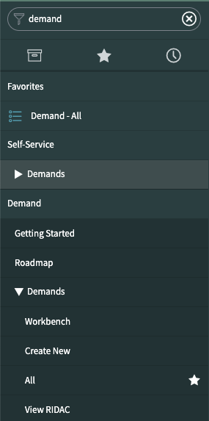
Application Navigator and Favorites
1
1. Using the Application Navigator
Type in the Application Navigator search field to find what you need in ServiceNow.
In this example, by typing ‘Demand’ in the navigator, it is a faster way to find the applications you want.
2. Creating a Favorite
Click on the star icon to the right of the topic. You may either individually create a favorite of a single topic such as Demand > Demands > All or select Demand at the top level to make all child topics a favorite.
Favorites are shown when you click on the star icon below the Application Navigator.
3. Using the History feature
The clock icon below the Application Navigator lists your history of recently viewed records with the most recent at the top. Use this feature to quickly go back to a record.
3
2

Slide 9
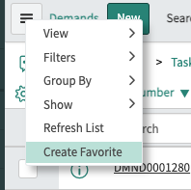
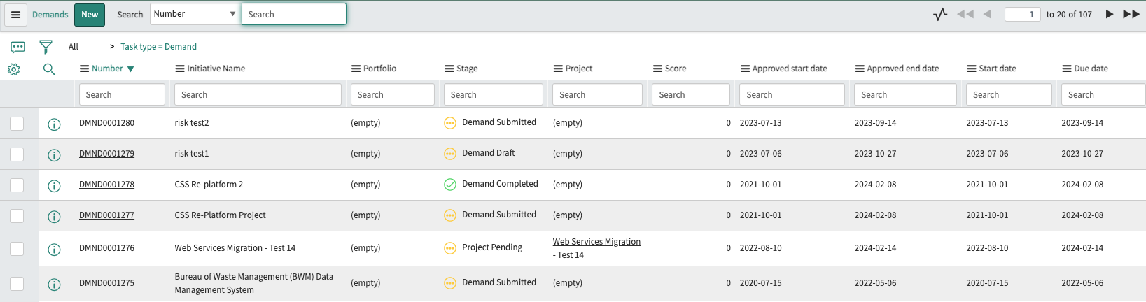
List View
List View shows data from a specific table in ServiceNow. In the example below, this view is the Demand > Demands > All search done on the previous slide. Each column is a data field on the Demand record.
1. The Context Menu allows you to create your personalized list view as a Favorite.
2. The filter allows you to create a specific search for records without changing your list view.
3. The gear icon allows you to personalize the list view to move columns left or right, as well as add or remove columns.
1
2
3

Slide 10
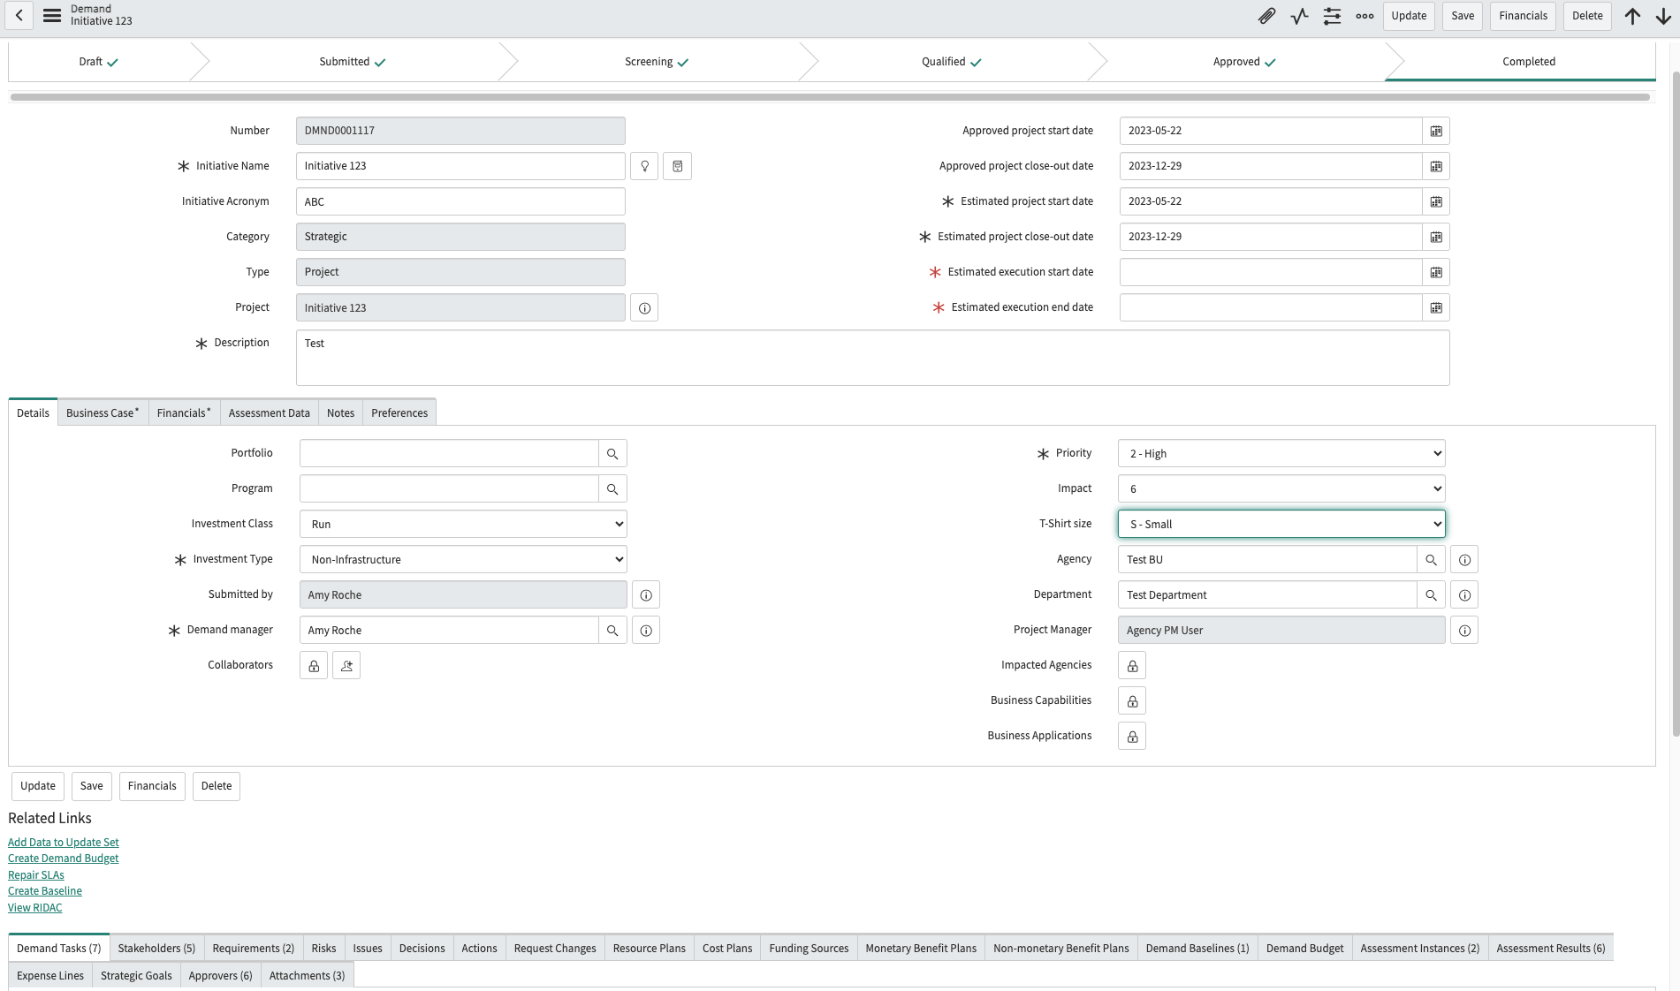
Form Basics
1. Form
User interface buttons
Update: Saves your record and closed it.
Save: Saves your record and stays on the record.
Financials: Navigates to the Financial Workbench.
Delete: Deletes the record (may not be visible to all demand users)
2. Tabs
Additional information for the record
3. Related Links
Actions that can be taken from demand.
4. Related Lists
Links to other information that will be shared with a project record
1
2
3
4

Slide 11
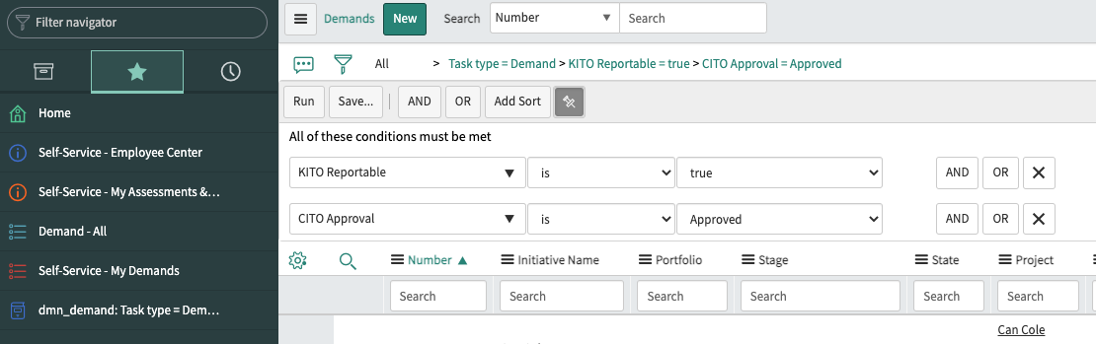
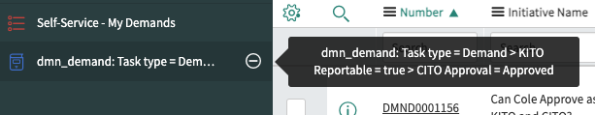
Creating a Favorite
Another way to create a favorite is to ‘drag and drop’ the breadcrumbs from your filter to the Application Navigator column.
1. Use the filter to set the conditions of the data you wish to see. The example below is to see all KITO Reportable Demands that have CITO approval. With your mouse, click on the breadcrumbs (Task type = Demand > KITO Reportable = true > CITO Approval = Approved), and drag it to the left to the Application Navigator column.
2. Hovering over the newly created favorite, you will see the breadcrumbs.
3. Under the Favorites icon, your favorite is shown.
3
1
2

Slide 12
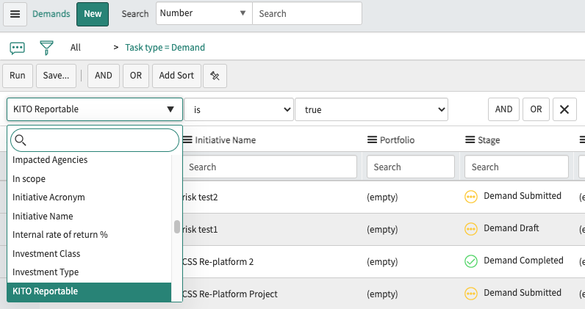
Filtering Your List View
Filtering your list view allows you to view specific data. The filter icon allows you to search for fields to view this data in a list view.
    1. Click on the filter icon. The ‘Run’, ‘Save’, ‘AND’, ‘OR’, ‘Add Sort’ and pin icon become available.
          Run: when you have completed your filter, click on this button to see the data results.
          Save: allows you to save this specific view.
          AND, OR: when searching for data, you may create a view that searches for multiple variables.
          Add Sort: allows you to add to your order results (e.g., Assignment group a to z, Active z to a).
          Pin icon: allows you to set the filter so it may be easily used on a specific list view.
          2. These are available form fields for your filter. Quickly find the field by typing in the search field. The operator which may change based on field type and values.
          3. The operator may change based on the field type and values.
1
3
2
Notes:
For the Demo: Show them how to filter for their Agency.

Slide 13

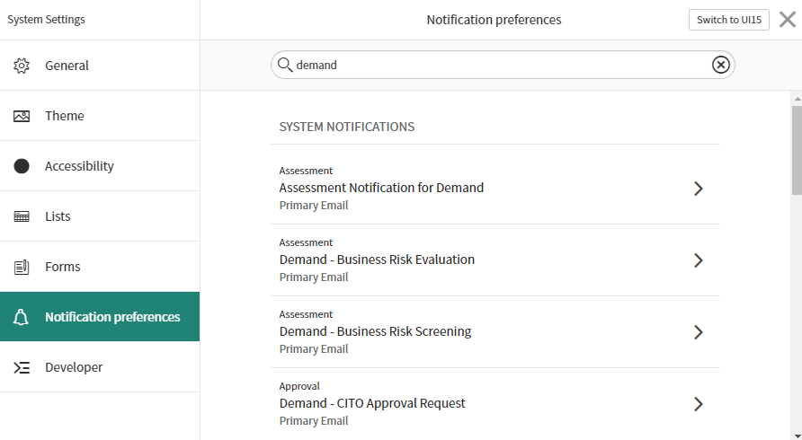
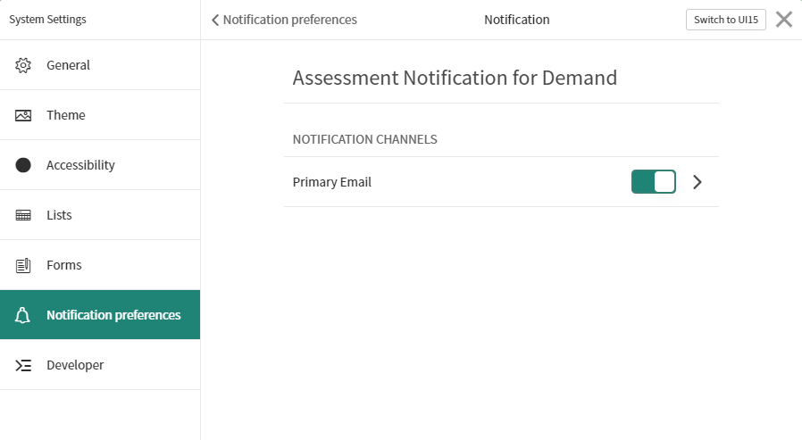
Notifications Management
ServiceNow can send a lot of notifications to email. Setting preferences in ServiceNow instead of filtering everything as it comes to your Inbox will ensure you see the emails you need to see. You will not get notifications for events that you trigger.
In the upper right, click on the gear icon. System Preferences will open, navigate to the Notification Preferences section.
                Search for ‘demand’ (or other types of records in ServiceNow) and select the notification you want to change.
                Use the slider to toggle messages on or off.
1
2
3

Slide 14
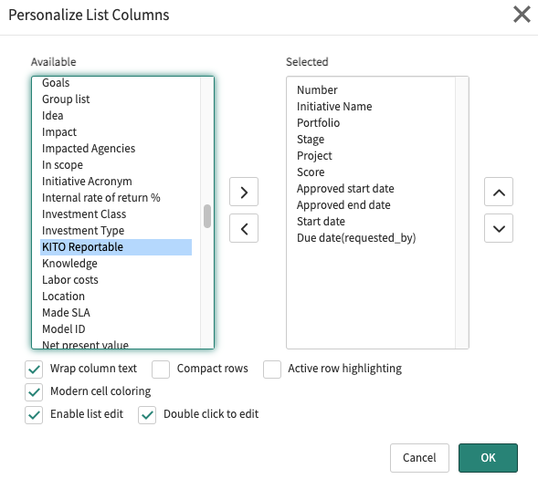
Personalize Your List View
List View shows the data from a specific table in ServiceNow. In the example below, each column is a data field on the record.
The gear icon allows you to personalize the list view to move columns left or right, as well as add or remove columns.
          Find the field you want to display, move it from ‘Available’ to ‘Selected’ by clicking on the arrow. You may also move fields under ‘Selected’ by selecting the field and moving it to ‘Available’.
                To personalize the list view from left to right, in the ‘Selected’ column, move fields to the top in the order you wish to view them from left to right.
                Click the ‘OK’ button.
1

Slide 15



User Interface Buttons
ServiceNow uses User Interface (UI) buttons at the top of their forms in all their applications.
Save – saves the record and stays on the record.
Insert & Stay – creates a copy of the current record with any modified values, and redirect to the new record.
Update - saves the record and closes it.

Slide 16
Demand Management Overview

Slide 17
IT Demand Request to Project
Demand
Stakeholders
Assessments / Approvals
Benefit / Cost Plans
Funding Sources
Tasks / Requirements
Project
Planning / Tracking
Status Reports
Approvals
Benefit / Cost Plans
Tasks
IT Demand
Demand
Intake
Approved
Demand
Service Portal

Slide 18
Demand End-to-End Process Flow
Correction After Rejection
Draft
Submitted
Screening
Qualified
Approved
Completed
Rejected Approval
Project
The Demand Manager completes Demand Tasks for SOW/RFP, IV&V and Feasibility Study documentation (if required).
Compliance Acknowledgement completed.
Executive Authority approval.
A Demand draft may be created on the service portal or by the Demand Manager.
The Demand Manager updates the demand details and submits when ready.
Demand Manager completes Kansas IT Business Risk Assessment.
Cost plans, benefit plans, funding sources are created.
Financial information on cost of ownership and length of commitment defined.
KITO completeness review.
JCIT advise and consult.
CITO approval.
If CITO approves demand, Approved state is automatically completed.
If CITO approves the demand, the demand is automatically set to Completed and the Project record is automatically created. Agency is authorized to begin procurement.
Notes:
EA Authority approval takes the place of EA cover letter.

Slide 19
Process Objectives
Demand Management
Process Goal:
Capture relevant data and justification in demand records for purposes of evaluation, comparison, prioritization, and approval for IT projects that are KITO Reportable.
Process Objectives:
Provide a single-entry point for demands
Capture, centralize and assess demands
Real-time visibility into prioritized, categorized and justified demands to ensure that the KITO qualified and non-KITO qualified demands have oversight for agencies across the State
Improve visibility and communication with key IT stakeholders and project managers
Process Relationships:
When Demands are Approved, they will become Projects
Cost Plans, Benefit Plans and RIDACs can be generated from Demand
Notes:
All new projects need the demand screening process. If certain thresholds are met, additional risk screening is required.

Slide 20
Process Roles
Demand Manager for KITO Projects:
Manage the day-to-day activities of the demand management process.
Activities
Enter detailed Demand information
Populate and manage Stakeholder list and attributes
Communicate with stakeholders and collaborators to create the Business Case
Complete the business risk assessment and evaluation surveys
Create Benefit Plans / Cost Plans / Funding Sources
Enter Risks / Issues / Decisions / Actions / Changes (RIDAC) when applicable
Monitor the approval processes
Stakeholders:
These stakeholders have been identified as approvers or key contributors. The available stakeholders are populated by user records in ServiceNow. Additional stakeholders may be requested to be added.
Sponsor / Business Owner
PMO Director
Finance Director / CFO
IT Director / CIO
Executive Authority
Activities
Enter detailed Demand information

Slide 21
Demand Management States
Draft | Submitted | Screening | Qualified | Approved/ Completed/ Deferred
Either created from the Employee Center portal or directly as a Demand | Assign Demand Manager Demand Manager collects information (e.g., benefit plans, cost plans, funding sources) Demand Manager completes business risk assessments Demand Manager works with stakeholders to build the business case | Demand Tasks are completed Demand Manager works with stakeholders to enhance the demand to prepare for Executive Authority review Executive Authority approval allows Demand Manager to move demand to Qualified state | KITO Completeness Review and JCIT Advise and Consult CITO approvals Approve, defer or send the demand back for further evaluation CITO approval of IT demand automatically creates a project | For approved Demands, project is automatically created Deferred Demands(Rejected Approvals) will remain in the system and can be reset to draft if circumstances change the value or risk propositions

Slide 22
Demand Intake

Slide 23
Demand End-to-End Process Flow
Correction After Rejection
Draft
Submitted
Screening
Qualified
Approved
Completed
Rejected Approval
Project
The Demand Manager completes Demand Tasks for SOW/RFP, IV&V and Feasibility Study documentation (if required).
Compliance Acknowledgement completed.
Executive Authority approval.
A Demand draft may be created on the service portal or by the Demand Manager.
The Demand Manager updates the demand details and submits when ready.
Demand Manager completes Kansas IT Business Risk Assessment.
Cost plans, benefit plans, funding sources are created.
Financial information on cost of ownership and length of commitment defined.
KITO completeness review.
JCIT advise and consult.
CITO approval.
If CITO approves demand, Approved state is automatically completed.
If CITO approves the demand, the demand is automatically set to Completed and the Project record is automatically created. Agency is authorized to begin procurement.
Notes:
EA Authority approval takes the place of EA cover letter.

Slide 24
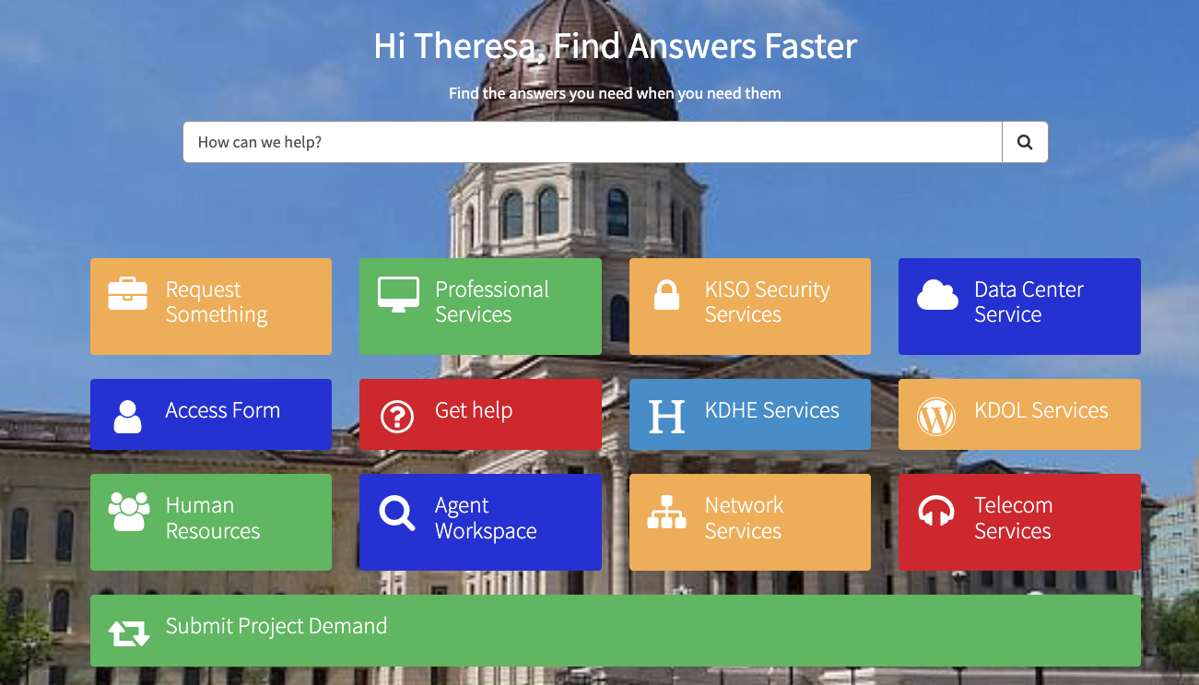
Demand Intake: Employee Center
For training, use this link: https://ksgovtest.servicenowservices.com/oits or https://ksgovtest.servicenowservices.com/csm. Do not create records in production to familiarize yourself with this new process.
Navigate to the OITS Portal (OITS users) https://ksgov.servicenowservices.com/oits or CSM Portal (non-OITS users) https://ksgov.servicenowservices.com/csm. Click on ‘Submit Project Demand’.
After the demand is created, you will continue the demand workflow on the ServiceNow platform.
Notes:
If you wish, you may navigate to the service portal and follow along from there. https://ksgovtest.servicenowservices.com/oits

Slide 25
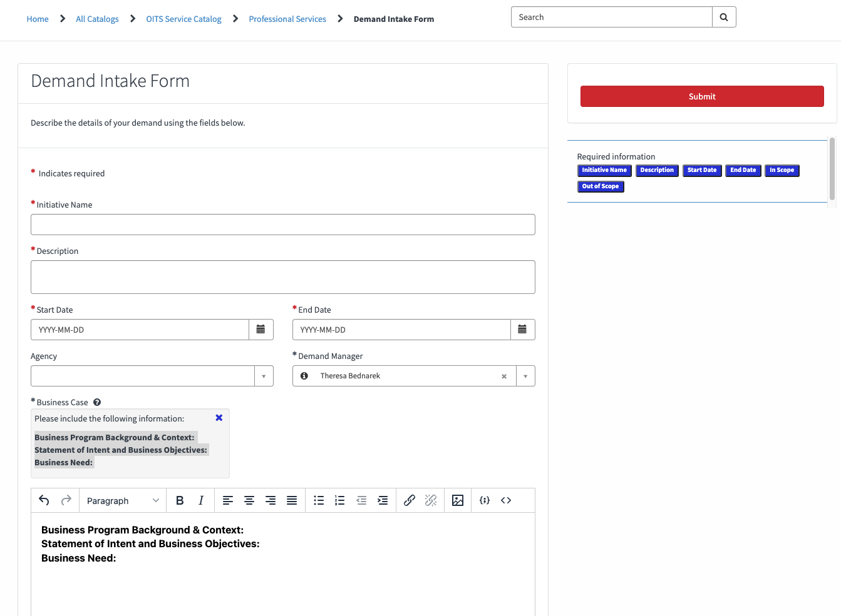
Demand Intake: Demand Intake Form
All field names with an asterisk (*) are required fields. Under the ‘Submit’ button, there is a list of Required Information.
When describing the Business Case, include:
Business Program Background and Context
Statement of Intent and Business Objectives
Business Need
NOTE: The In scope and Out of Scope fields are required and must be filled out to submit the demand request.
1
2

Slide 26
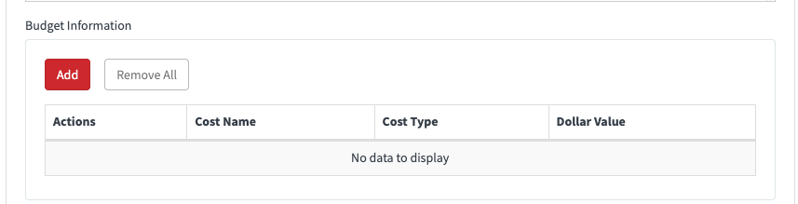
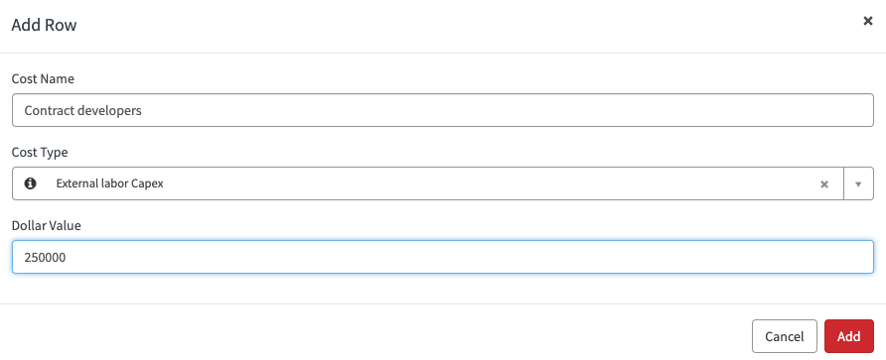
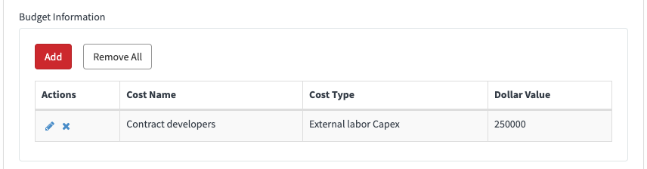
Demand Intake: Cost Plans
If capital or operational expenses are known, they may be entered under ‘Budget Information’. This information will be added to the Cost Plans Related List on the Demand record.
Click on the ‘Add’ button.
Name the cost plan, select a Cost Type and provide the Dollar Value. Click on the ‘Add’ button.
Budget information will be shown when this is completed.
1
2
3

Slide 27
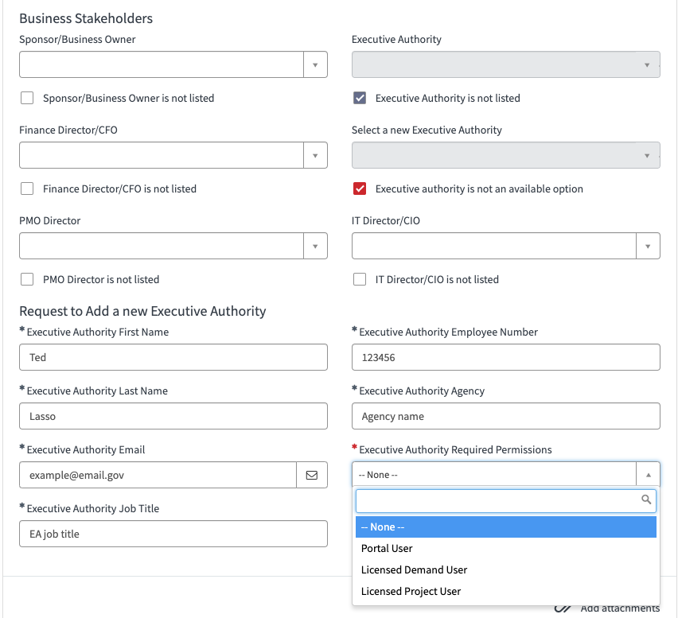
Demand Intake: Adding Stakeholders
The following stakeholder types must be added to the request:
Sponsor / Business Owner
PMO Director
Finance Director / CFO
IT Director / CIO
Executive Authority
If the stakeholder is not listed, click on the checkbox beneath each stakeholder field. Then make a selection from the ‘Select a new [stakeholder type]’ field.
If the stakeholder desired is not listed, click on the checkbox ‘[stakeholder type] is not an available option’.
The ‘Add a new [stakeholder type] fields appear to provide their name and additional details to consider the request.
A KITO staff member will review the request and determine if the stakeholder should be added to ServiceNow.
1
2
3
Notes:
Try to fill this out but if you don’t know the stakeholders at this point of the workflow, you may still submit the form.
Select Portal User if you aren’t sure what permissions the stakeholder requires.
Early on, you may not see the users you need. But over time you will as you use SN more for this workflow.

Slide 28
Demand Intake: New Stakeholders Workflow
If the stakeholder is not listed, the Submitter (Demand Manager) clicks on the checkbox beneath the stakeholder field to create a Request for a new user in ServiceNow.
KITO reviews the request and if it is approved, it is routed to the OITS ServiceNow Admin team.
ServiceNow admins create a new user in ServiceNow.
ServiceNow admins will include a note to the Demand Manager to advise them to associate the new user to the demand.
The Demand Manager receives a notification that the requested stakeholder is available in ServiceNow.
The Demand Manager creates a Stakeholder record and associates them to the demand.
NOTE: For details on creating stakeholder register records, refer to the Stakeholder Related List slides.
New Stakeholder Request submitted
by Submitter (Demand Manager)
1
KITO reviews Request
2
KITO approves Request
OITS SN Admins create new
user in sys_user table
3
OITS adds note in Request advising DM
to associate the new user to the demand
and closes Request
4
DM receives notification that requested
Stakeholder is available in ServiceNow
5
DM creates stakeholder record and
associates them to the demand
6

Slide 29
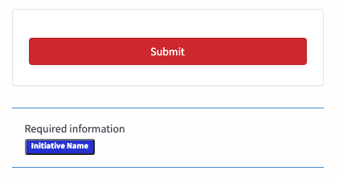
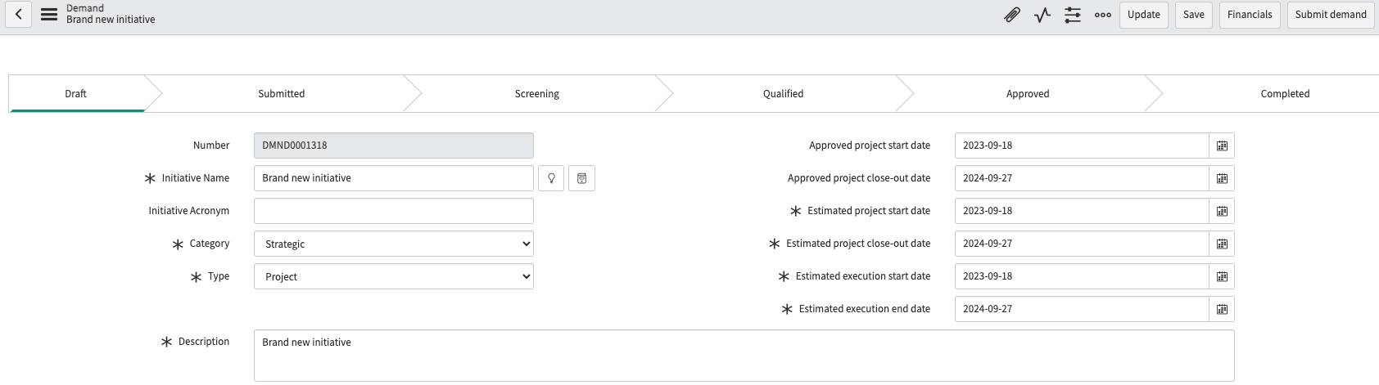
Demand Intake: Submit Demand Form
Ensure all field names marked with an asterisk (*) are populated.
If any required fields are not populated, they will be listed under ‘Required Information’ underneath the Submit button.
Once the demand has been submitted, the form will automatically open on the ServiceNow platform in the Draft state.
NOTE: You cannot save this form and come back to it later. Open the form when you have the information you need to submit your IT project demand.
1
2

Slide 30
Draft Demand

Slide 31
Demand End-to-End Process Flow
Correction After Rejection
Draft
Submitted
Screening
Qualified
Approved
Completed
Rejected Approval
Project
The Demand Manager completes Demand Tasks for SOW/RFP, IV&V and Feasibility Study documentation (if required).
Compliance Acknowledgement completed.
Executive Authority approval.
A Demand draft may be created on the service portal or by the Demand Manager.
The Demand Manager updates the demand details and submits when ready.
Demand Manager completes Kansas IT Business Risk Assessment.
Cost plans, benefit plans, funding sources are created.
Financial information on cost of ownership and length of commitment defined.
KITO completeness review.
JCIT advise and consult.
CITO approval.
If CITO approves demand, Approved state is automatically completed.
If CITO approves the demand, the demand is automatically set to Completed and the Project record is automatically created. Agency is authorized to begin procurement.
Notes:
EA Authority approval takes the place of EA cover letter.

Slide 32
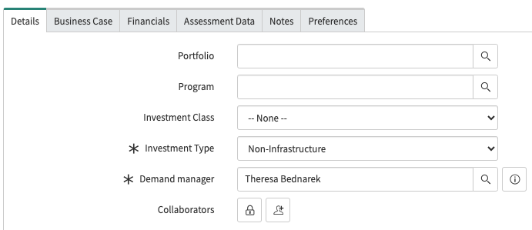
Draft Demand: Select Investment Type
The Investment Type field on the Details tab defines if the IT project is Infrastructure or Non-Infrastructure related.
This field defaults to Non-Infrastructure. You must update this field if your IT project is Infrastructure related.
Based on the Investment Type selected, this changes the fee associated with the project.

Slide 33
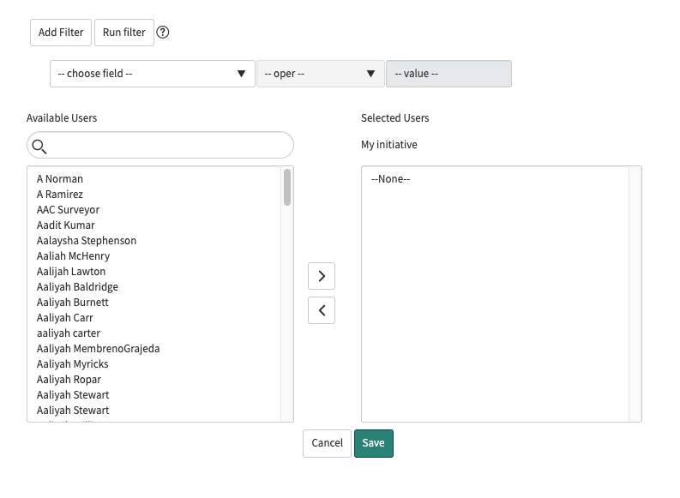
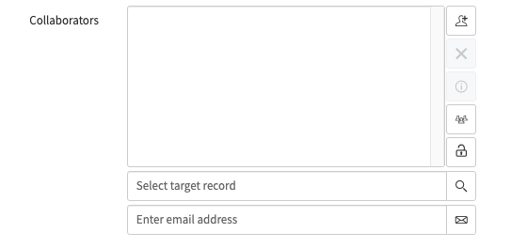
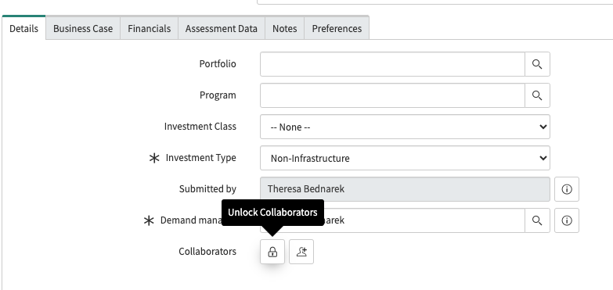
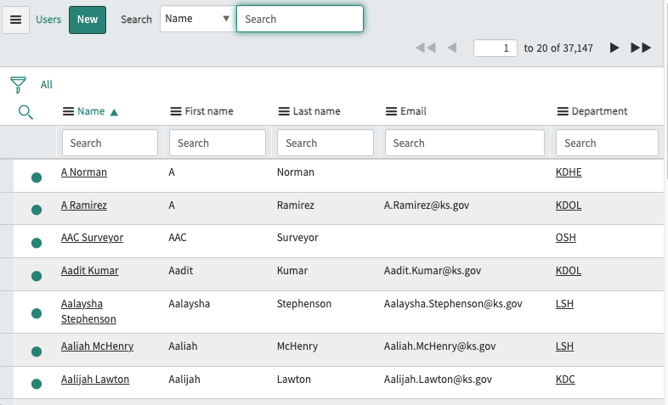
Draft Demand: Adding Collaborators
Collaborators can be added if they need to edit the demand in the Draft state.
1. On the Details tab, click on the lock icon to add people who should have information on the demand but do not have any actionable tasks.
2. You may add multiple people (group icon) or individuals (magnifying glass icon).
3. Click on the unlocked icon when you are done adding collaborators.
NOTE: Collaborators without demand permissions can access demands from the Self-Service section of the Application Navigator.
1
2
3

Slide 34
Draft Demand:
If a demand is rejected in any part of the approval process, it will be reset to the Draft state and must be resubmitted.
You must make updates requested by the Approver and resubmit the demand.

Slide 35

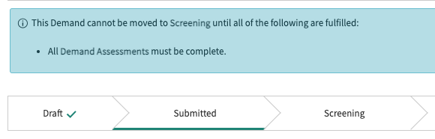
Draft Demand: Move to Submitted
When the demand is ready to be submitted, click on the ’Submit demand’ button in the header.
The demand workflow will reflect the demand is in the Submitted state.

Slide 36
Submitted Demand

Slide 37
Demand End-to-End Process Flow
Correction After Rejection
Draft
Submitted
Screening
Qualified
Approved
Completed
Rejected Approval
Project
The Demand Manager completes Demand Tasks for SOW/RFP, IV&V and Feasibility Study documentation (if required).
Compliance Acknowledgement completed.
Executive Authority approval.
A Demand draft may be created on the service portal or by the Demand Manager.
The Demand Manager updates the demand details and submits when ready.
Demand Manager completes Kansas IT Business Risk Assessment.
Cost plans, benefit plans, funding sources are created.
Financial information on cost of ownership and length of commitment defined.
KITO completeness review.
JCIT advise and consult.
CITO approval.
If CITO approves demand, Approved state is automatically completed.
If CITO approves the demand, the demand is automatically set to Completed and the Project record is automatically created. Agency is authorized to begin procurement.
Notes:
EA Authority approval takes the place of EA cover letter.

Slide 38
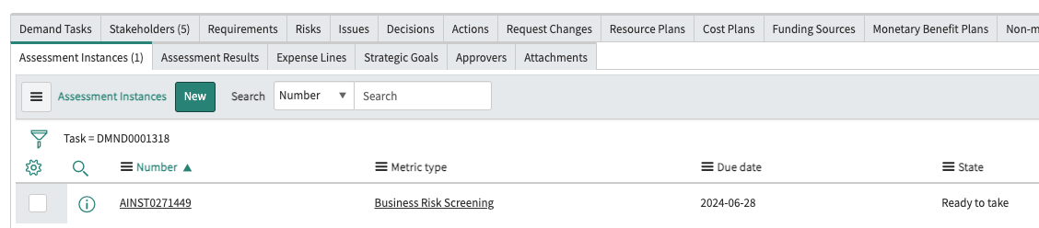
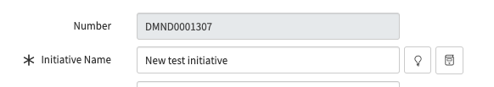
Submitted Demand: Kansas IT Business Risk Screening
All demands will automatically create a Business Risk Screening Assessment that is completed by the Demand Manager. The business risk evaluation depends on the result of the risk screening.
NOTE: You cannot retake or edit the assessments once they are submitted. It is critical to collaborate and fill it out accurately so that you will not have to create a new demand.
The Assessment Instances Related List shows the assessment. Click on the ‘Number’ column and not any other fields to access the assessment.
Note the demand number to easily find your assessment when you navigate to: Self-Service > My Assessments & Surveys

Slide 39
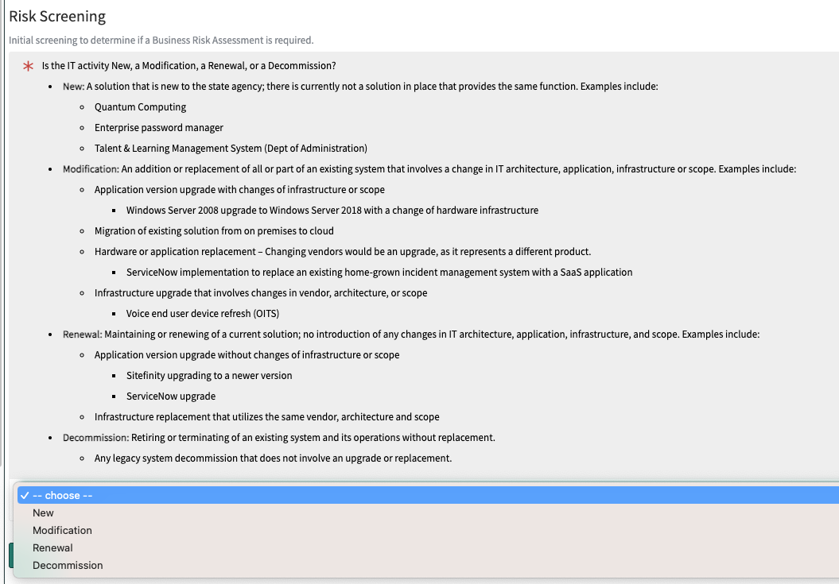
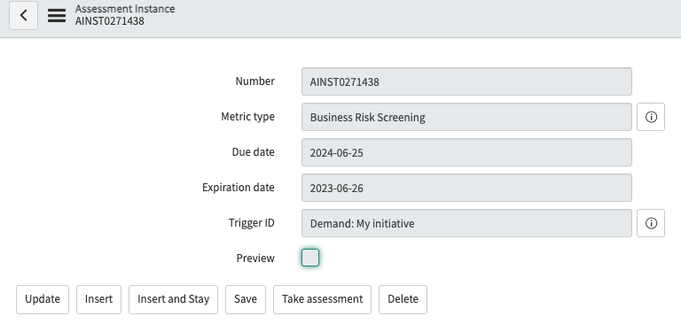
Submitted Demand: Business Risk Screening
1. From the Assessment Instances Related List, click on the ‘Number’ column. Do not click on any other column because this will not lead to opening the assessment.
2. Click on the ‘Take Assessment’ button on the Assessment Instance record which will open the assessment.
NOTE: You cannot retake or edit the assessments once they are submitted. It is critical to collaborate and fill it out accurately so that you will not have to create a new demand.
1
2

Slide 40
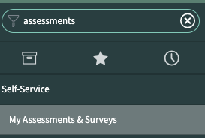
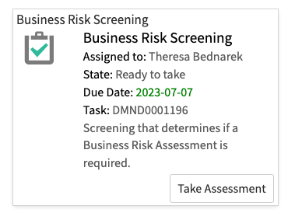
Submitted Demand: Business Risk Screening
Navigate to Self-Service > My Assessments & Surveys to find the assessment. Note the demand number to find your assessment more easily if there are multiple assessments pending. Click on the ‘Take Assessment’ button. Depending on the the risk screening responses, a second risk assessment to evaluate the demand may be created.

Slide 41
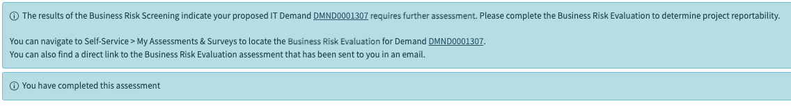
Submitted Demand: Business Risk Screening
When the screening assessment is completed, it may trigger a Business Risk Evaluation. If a risk evaluation is required, you will be prompted with a message (see below).
You are instructed to navigate to My Assessments & Surveys to complete this assessment.

Slide 42
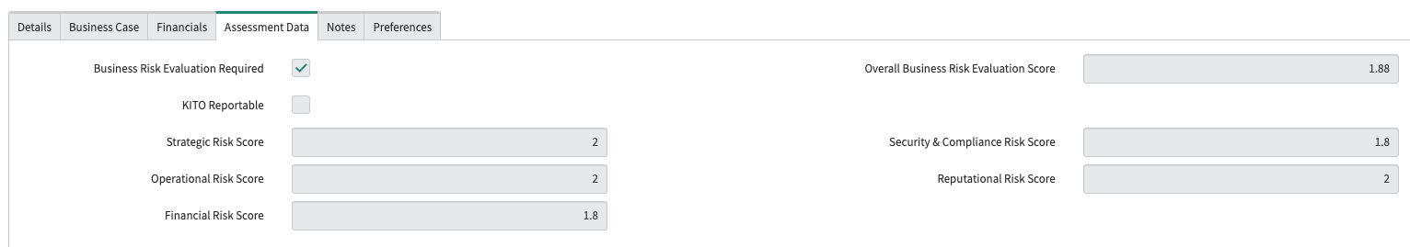
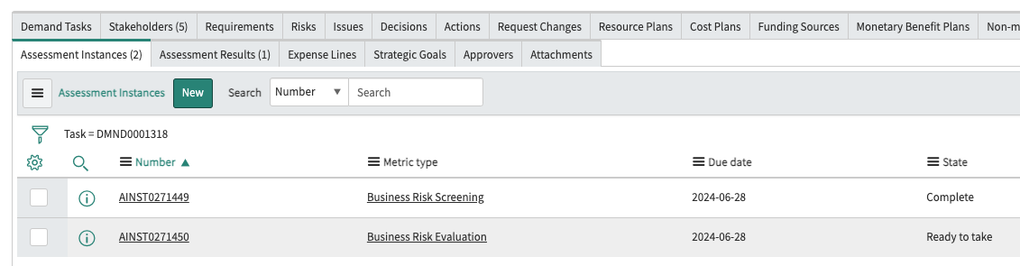
Submitted Demand: Business Risk Evaluation
If a Business Risk Evaluation is required based on the Business Risk Screening assessment, the Assessment Data tab will have the ‘Business Risk Evaluation Required’ checkbox as true.
On the Assessment Instances Related List, a Business Risk Evaluation assessment is created for the Demand Manager to submit.
1
2

Slide 43
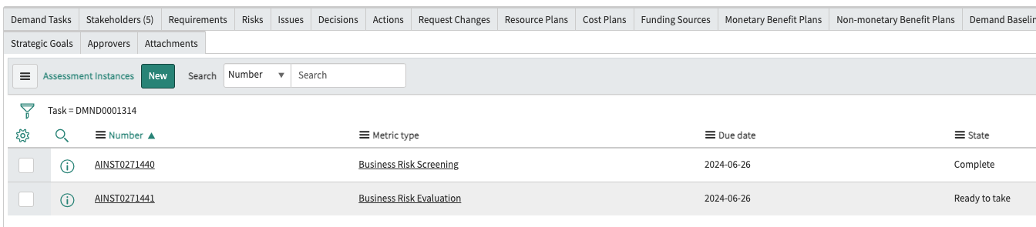
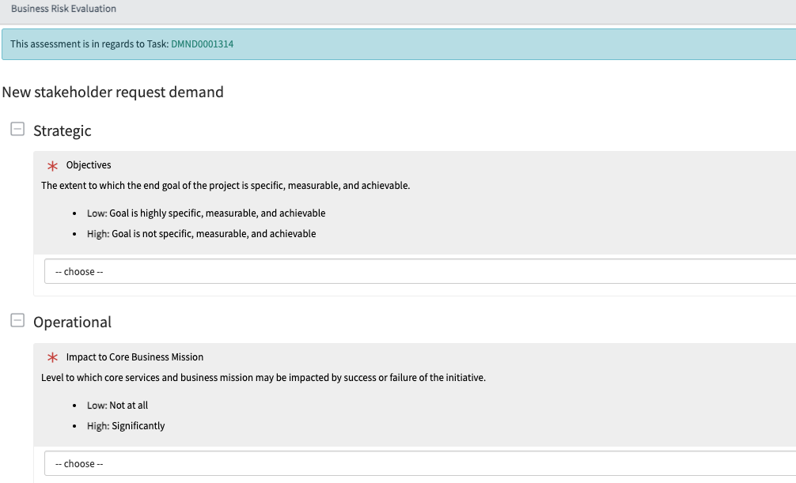
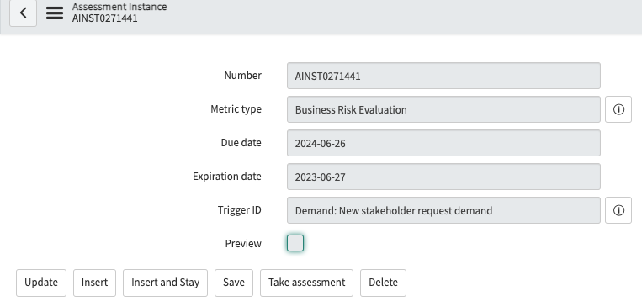
Submitted Demand: Business Risk Evaluation
1. From the Assessment Instances Related List, click on the ‘Number’ column. Do not click on any other column because this will not lead to opening the assessment.
2. Click on the ‘Take Assessment’ button on the Assessment Instance record which will open the assessment.
NOTE: You cannot retake or edit the assessments once they are submitted. It is critical to collaborate and fill it out accurately so that you will not have to create a new demand.
1
2

Slide 44
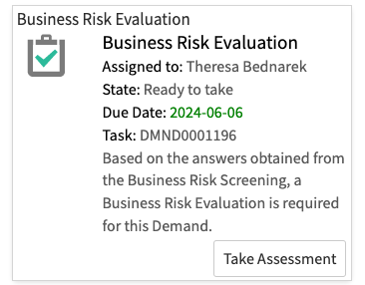
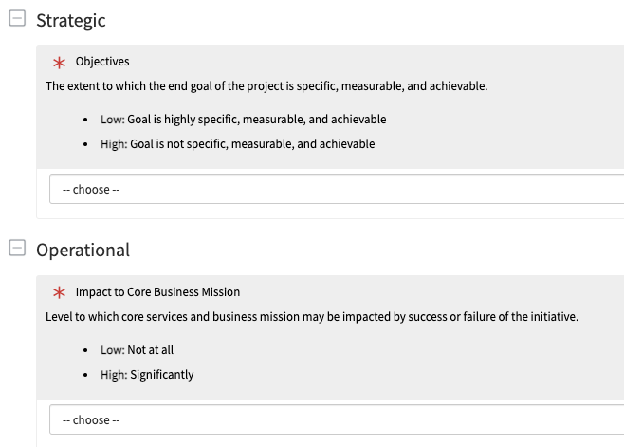
Submitted Demand: Business Risk Evaluation
Navigate to Self-Service > My Assessments & Surveys to find the assessment. Note the demand number to find your assessment more easily if there are multiple assessments pending. Click on the ‘Take Assessment’ button. This assessment to address the following areas: Strategic, Operational, Financial, Security & Compliance and Reputational.

Slide 45
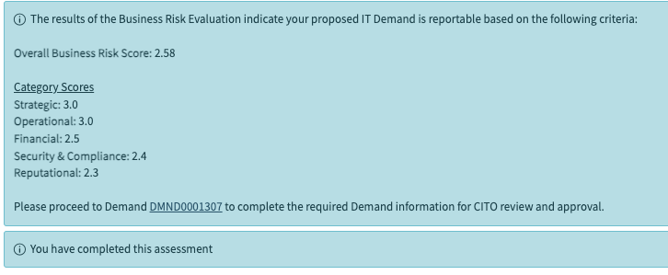
Submitted Demand: Business Risk Evaluation
When the evaluation assessment is completed, the risk evaluation scores will be shown.
You will be prompted to complete the required Demand information CITO review and approval.

Slide 46
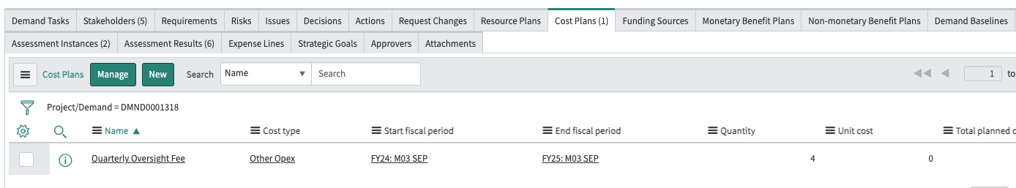
Submitted Demand: Quarterly Oversight Fee Cost Plan
Once all assessments are completed, if the demand is KITO Reportable, an estimated Quarterly Oversight Fee Cost Plan is automatically generated on the Cost Plans Related List. The Quarterly Oversight Fee Cost Plan will update when you make changes to Costs or Dates.
NOTE: Regardless of whether a Quarterly Oversight Fee is required or not, at least one Cost Plan is required to move the demand to be screened.

Slide 47
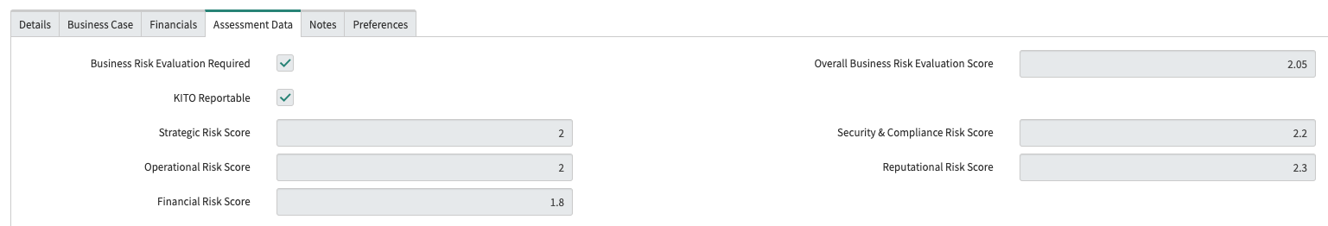
Submitted Demand: Assessment Completion
When the risk assessment(s) are complete, the Assessment Data tab reflects the Overall Business Risk Evaluation Score. If this score is:
    1.00 – 2.00, it is Non-reportable
    > 2.00, it is KITO reportable
    2.51 – 3.00, it requires Feasibility Study Report and if over $10 million must have IV&V completed
If the Overall Business Evaluation Score is 2.01- 3.00, it is a KITO Reportable demand.
If the numbers do not look right, the Assessments cannot be edited or restarted, a new Demand will be required.
NOTE: Once assessments are complete, they cannot be edited or changed. If it is necessary to have different values, a new demand must be created.
1
2

Slide 48
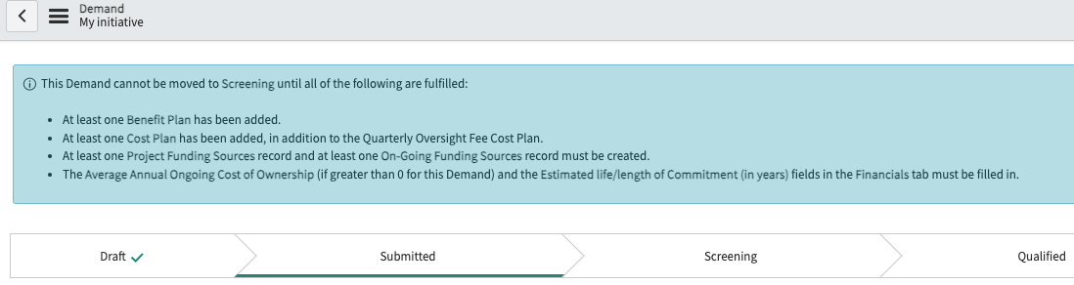
Submitted Demand: Required Information
When the risk assessment(s) are complete, a blue banner message will inform you of what must be included in the demand to progress to the Screening state. As each item is completed, the blue banner will update until the demand may move to the next state.

Slide 49
Financial Management Overview
When estimated costs are over $10 Million, Feasibility Study Report and IV&V are required.
Cost and Benefit Management
  DA 518 worksheet will be replaced with Cost Plans.
  DA 519 worksheet will be replaced with Benefit plans.
Funding sources were captured on DA518
  Funding sources are collected separately.
  PMs enter funding info and percentage estimates.
  Funding percentages are linked to Cost Plans to show dollar value in addition to percentages.
  Funding types will improve reporting.
KITO Oversight Fee is automatically calculated and kept updated from Cost Plan data.

Slide 50
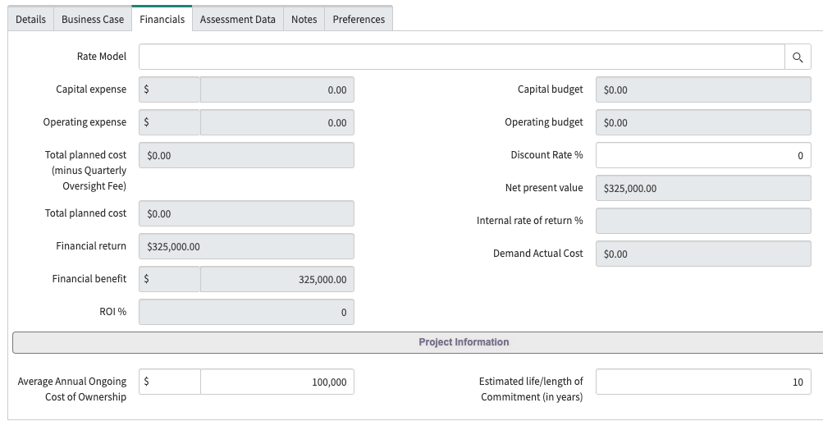
Submitted Demand: Financials Tab
On the Financials tab, required information must be added to define:
Average Annual Ongoing Cost of Ownership – estimated annual ongoing cost of ownership.
Estimated life/length of Commitment (in years) – the number of years the solution is expected to be in place.

Slide 51
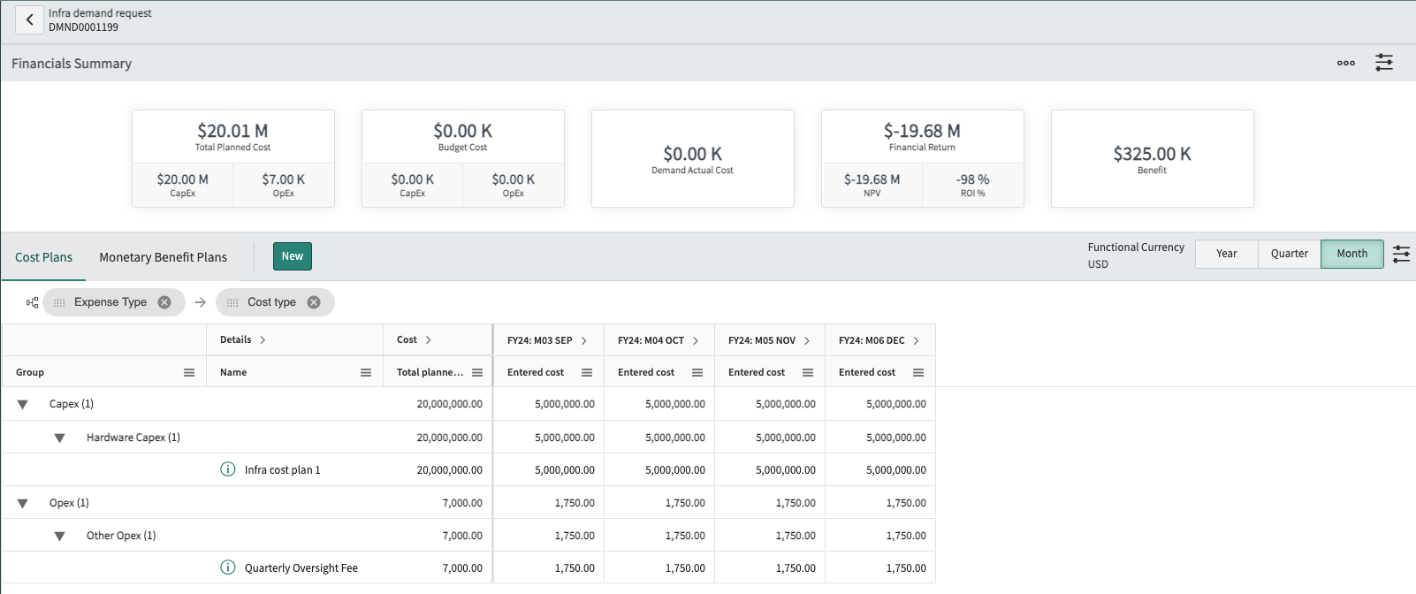
Managing Financials from the Workbench
The Financial Workbench provides a dashboard to view all Cost Plans and Monetary Benefit Plans for your initiative. To access the workbench, click on the ‘Financial’ button in the demand header or click on the ‘Manage’ button in the related list.
You can manage Cost Plans and Monetary Benefit Plans from here.
Click on the tab you want then click on the ‘New’ button to create a new plan.

Slide 52
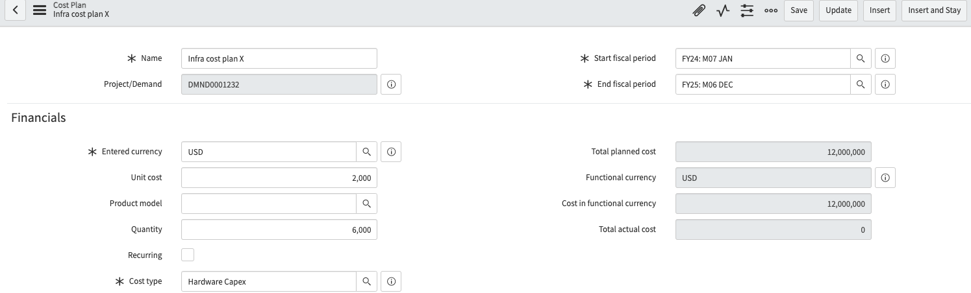
Submitted Demand: Creating Cost Plans
You must create at least one Cost Plan if the demand did not have any budgetary information upon submission.
Click the ‘New’ button from the Cost Plan Related List or from the Financial Workbench.
Name the cost plan.
Populate the fiscal start and end dates.
Fill out the Unit cost and Quantity fields.
If the cost is recurring for each fiscal period, check the Recurring checkbox.
Select the Cost type (e.g., CapEx, OpEx).
When creating multiple cost plans, use the ‘Insert and Stay’ button to make a copy of your current cost plan to create another cost plan.

Slide 53
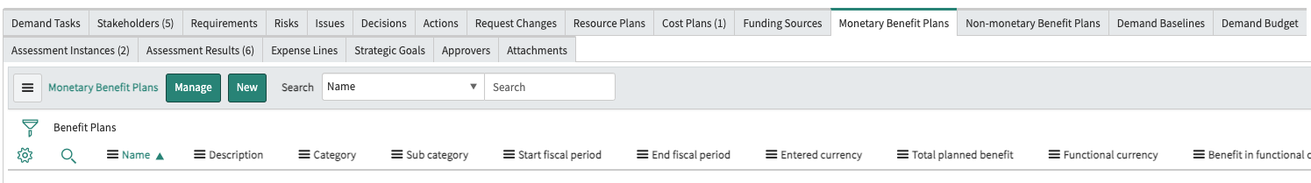
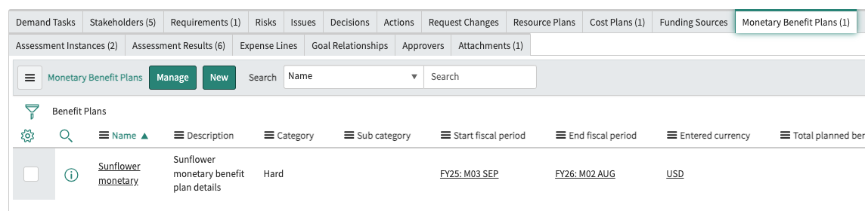
Submitted Demand: Creating Benefit Plans
There are two types of Benefit Plans: Monetary and Non-monetary. These plans capture the potential benefits accrued by the demand when it has been executed.
Navigate to the Monetary Benefit Plans or Non-monetary Benefits Related List and click on the ‘New’ button.
Click on the ‘Manage’ button to create a new Monetary Benefit Plan from the Financial Workbench.
NOTE: Do not use the ‘Insert and Stay’ function to create different benefit plans once they are saved. Create Monetary Benefit Plans from its respective related list and Non-monetary Benefit Plans from its related list. If you are creating multiple monetary benefit plans, this functionality may be used.
1
2

Slide 54
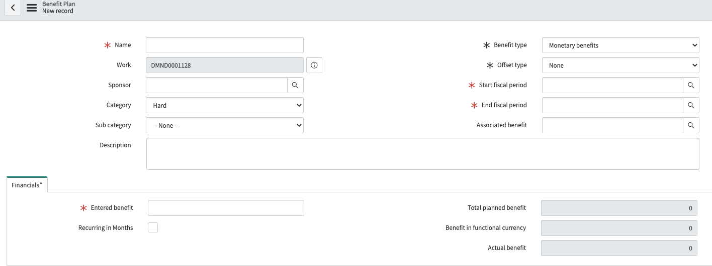
Submitted Demand: Creating Monetary Benefit Plans
1. Name the benefit plan.
2. Select the Category and Sub category.
Provide details on the benefit plan in the Description field.
3. The Benefit type field will default to the related list you are working from. It may be changed if the record has not been saved.
Select the type of Offset type to indicate when benefits start to be realized.
Populate the Start and End fiscal periods if the Offset type = None
Click Save when you have completed the plan.
1
3
2
NOTE: Monetary Benefit Plans should be created if you have a financial component to your project.

Slide 55
Submitted Demand: Monetary BP - Financials Tab
Entered benefit: Dollar amount.
Recurring in Months: If the dollar amount entered in the Entered benefit field will be realized each month of the fiscal periods.
Total planned benefits: Total benefits over the fiscal periods above.
Benefit in functional currency: Total benefits over the fiscal periods above.
Actual benefit: Total benefits over the fiscal periods above.
Click Save when you have completed the plan.
NOTE: Monetary Benefit Plans should be created if you have a financial component to your project.

Slide 56
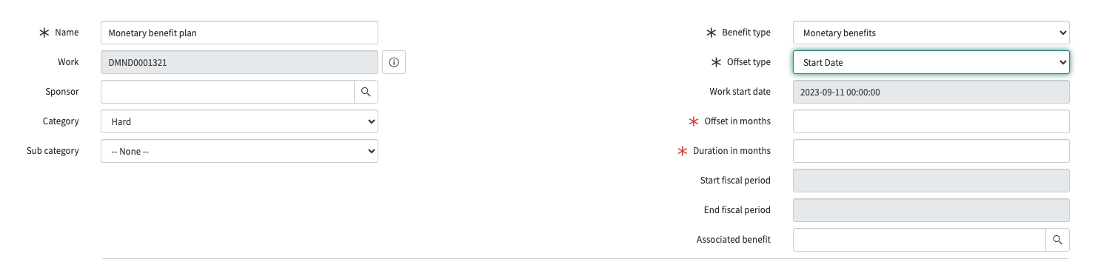
Submitted Demand: Benefit Plans - Offset Types
Offset type: If Start Date is selected, this defines the period of time that will delay the start of the benefit plan.
Work start date: Defaults to the project start date.
Offset in months: Define the number of months beyond the value selected in the Offset type field to start tracking benefits.
Duration in months: Define how long benefits will be tracked.
Start fiscal period and End fiscal period fields become read-only.

Slide 57
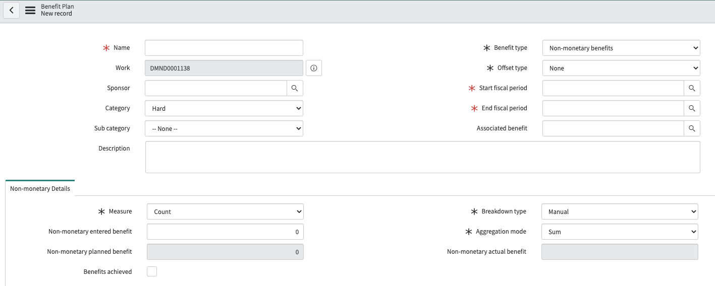
Submitted Demand: Creating Non-Monetary Benefit Plans
Name the benefit plan.
Select the Category and Sub category.
Provide details on the benefit plan in the Description field.
The Benefit type field will default to the related list you are working from. It may be changed if the record has not been saved.
Select the type of Offset type to indicate when benefits start to be realized.
Populate the Start and End fiscal periods if the Offset type = None.
Click Save when you have completed the plan.
1
3
2
NOTE: Non-Monetary Benefit Plans should be created if you have a social impact to your project.

Slide 58
Submitted Demand: Creating Non-Monetary Benefit Plans
Non-monetary Details tab
Select the Measure of the benefit plan. The choice options are:
Count
Percentage
Hours
Days
Score
Yes/No
Non-monetary entered benefit: Is based on the Measure, this defines how much of the measure was achieved.
Benefits achieved checkbox: If the benefits were achieved in the plan, select the checkbox.
Click Save when you have completed the plan.
NOTE: Non-Monetary Benefit Plans should be created if you have a social impact to your project.

Slide 59



Submitted Demand: Creating Funding Sources
Navigate to the Funding Sources Related List and click on the ‘New’ button. NOTE: There must be at least one Project Funding and On-Going Funding Source record. Each type of funding must equal 100. The blue banner will update as funds are added to the demand.
1. Fill out the Name of Fund field.
2. Populate the % of Funding field (e.g., 50, 100).
3. The Funding Source field indicates if Project Funding or On-Going Funding.
4. The Type of Funding field defines the funding source based on the Funding Source field.
5. If the Type of Funding = Other, a text field appears for you to describe the funding source.
When creating multiple cost plans, use the ‘Insert and Stay’ button to make a copy of your current cost plan to create another cost plan.
Click Save when you have completed the plan.
1
3
2
4
c
5
Notes:
Note: OITS process asked for Funding Sources with current workflow….Ongoing funding sources have not been requested in the past.

Slide 60


Submitted Demand: RIDACs
RIDAC stands for:
Risk
Issue
Decision
Action
Request Changes
If any of these should be added to the demand, click on the ‘New’ button on its respective related list.

Slide 61
Submitted Demand: Reset to Draft and Defer
Reset to Draft: A demand may be set back to the Draft state from any of the demand states or until a Project is created from an approved Demand. A confirmation message appears if there are:
Active assessments pending
The demand is moved to the Draft state and all active assessments are canceled. New assessments are triggered when the demand moves to the Screening state.
Defer: A demand may be deferred or placed on hold. A deferred demand may be reset to the Draft state or Approved.
The table below shows when demands may be deferred and reset to the Draft state.
State | Reset to Draft, Defer Available
Draft | None
Submitted | Defer
Screening | Defer
Qualified | Defer
Approved | Reset to Draft
Completed | None
Defer | Reset to Draft

Slide 62


Submitted Demand: Move to Screening
When the demand is ready to be screened, click on the Screen’ button in the header.
2. The demand workflow will reflect the demand is in the Screening state.

Slide 63
Screened Demand

Slide 64
Demand End-to-End Process Flow
Correction After Rejection
Draft
Submitted
Screening
Qualified
Approved
Completed
Rejected Approval
Project
The Demand Manager completes Demand Tasks for SOW/RFP, IV&V and Feasibility Study documentation (if required).
Compliance Acknowledgement completed.
Executive Authority approval.
A Demand draft may be created on the service portal or by the Demand Manager.
The Demand Manager updates the demand details and submits when ready.
Demand Manager completes Kansas IT Business Risk Assessment.
Cost plans, benefit plans, funding sources are created.
Financial information on cost of ownership and length of commitment defined.
KITO completeness review.
JCIT advise and consult.
CITO approval.
If CITO approves demand, Approved state is automatically completed.
If CITO approves the demand, the demand is automatically set to Completed and the Project record is automatically created. Agency is authorized to begin procurement.
Notes:
EA Authority approval takes the place of EA cover letter.

Slide 65


Screened Demand: SOW / RFP
On the Demand Tasks Related List, the Statement of Work (SOW) / Request for Proposal (RFP) task is generated. The SOW or RFP document must be attached within the Demand Task record. Click on the record number to open the record.
Attach the SOW or RFP by clicking on the paperclip in the header. When this is complete, the attachment will show in the record header.
In the State field, select ‘Closed Complete’ and click on the ‘Update’ button to save the record and return to the demand.
NOTE: If there is no SOW or RFP, attach Word document explaining why.

Slide 66


Screened Demand: Feasibility Study Documentation
On the Demand Tasks Related List, the Feasibility Study Documentation task is generated for demands over $10M. The Feasibility Study Documentation document must be attached within the Demand Task record. Click on the record number to open the record.
Attach the Feasibility Study document by clicking on the paperclip in the header. When this is complete, the attachment will show in the record header.
NOTE: This document is not required for IT demands under $10M but may be added if desired.
In the State field, select ‘Closed Complete’ and click on the ‘Update’ button to save the record and return to the demand.

Slide 67


Screened Demand: Compliance Acknowledgement
On the Requirements Related List, the Compliance Acknowledgement record is generated. Click on the record number to open the record.
The Architectural Compliance attestation is an acknowledgement the state agency submitting the proposed demand complies with ITEC Policy 4010 and ITEC Policy 9500.
In the State field, select ‘Accepted’ (not Approved) and click on the ‘Update’ button to save the record and return to the demand.
NOTE: Tasks stay with the Demand, Requirements move to the Project.
Notes:
In training, explain the difference between Demand Tasks and Requirements and why tasks stay with the demand and requirements will be copied to the project record.

Slide 68

Screened Demand: IV&V
On the Requirements Related List, the Independent Verification & Validation Acknowledgement (IV&V) record is generated for Demands >$10M. Click on the record number to open the record.
The IV&V is an acknowledgement the state agency submitting the proposed demand complies with ITEC Policy 2510 A.
In the State field, select ‘Accepted’ (not Approved) and click on the ‘Update’ button to save the record and return to the demand.
ITEC Policy link will open in a new browser tab.

Slide 69



Screened Demand: Executive Authority Approval
Executive Authority approval is your Agency Secretary or similar role that is replacing the Agency Cover Letter Signature.
Ensure the Executive Authority is aware before completing your last task, because the email will send automatically after all Tasks/Requirements are closed.
When all required information has been entered, the Executive Authority will receive a notification to review and approve the request.
When all required information has been entered, the Executive Authority is sent an email notification to review the demand request.
If the Executive Authority approves the demand, the ‘Qualify’ button appears to move the demand to the Qualified state.
If the Executive Authority rejects the demand, it is sent back to the Draft state. NOTE: Assessments cannot be retaken.
1
2

Slide 70


Screened Demand: Move to Qualified
When all required information has been entered and the Executive Authority approves the demand, the ‘Qualify’ button is available to move the record to the Qualified state.
2. The demand workflow will reflect the demand is in the Qualified state.

Slide 71
Qualified Demand

Slide 72
Demand End-to-End Process Flow
Correction After Rejection
Draft
Submitted
Screening
Qualified
Approved
Completed
Rejected Approval
Project
The Demand Manager completes Demand Tasks for SOW/RFP, IV&V and Feasibility Study documentation (if required).
Compliance Acknowledgement completed.
Executive Authority approval.
A Demand draft may be created on the service portal or by the Demand Manager.
The Demand Manager updates the demand details and submits when ready.
Demand Manager completes Kansas IT Business Risk Assessment.
Cost plans, benefit plans, funding sources are created.
Financial information on cost of ownership and length of commitment defined.
KITO completeness review.
JCIT advise and consult.
CITO approval.
If CITO approves demand, Approved state is automatically completed.
If CITO approves the demand, the demand is automatically set to Completed and the Project record is automatically created. Agency is authorized to begin procurement.
Notes:
EA Authority approval takes the place of EA cover letter.

Slide 73

Qualified Demand: KITO Review
As KITO, JCIT, and CITO are reviewing, it is critical that the information does not change on the Demand record.
There will be a blue banner in the header that states KITO review and acceptance is required for KITO Reportable requests.
On the Requirements tab, it shows a pending action for KITO Review. Do not make any changes to your record until the KITO Review is completed.

Slide 74

Qualified Demand: KITO Review - Accepted
A member of the KITO staff will open the Requirements record and review it. When the record State is Accepted, the next level of review is triggered.
NOTE: If Approved is selected in the State field, the next task will not be triggered. Be sure to re-open the record and ensure the State field is Accepted.

Slide 75

Qualified Demand: KITO Review – Not Accepted
A member of the KITO staff will open the Requirements record and review it. When the record State is Rejected, KITO will add a work note (required) to explain what additional information is required for a follow-on KITO review.
For Demand Managers, when responding to a rejected KITO review, a notification is sent to them stating the KITO review is complete and requires corrections, clarifications and/or additional information. Notify KITO staff using the @[Assigned to] in the Work notes field on the Notes tab.

Slide 76


Qualified Demand: JCIT Review
There will be a blue banner in the header that states JCIT review and acceptance is required for KITO Reportable requests.
As KITO, JCIT, and CITO are reviewing, it is critical that the information does not change on the Demand record.
On the Demand Tasks Related List, the JCIT Review is generated following KITO acceptance. An email is sent to the JCIT staff to review, advise and consult on the demand.

Slide 77


Qualified Demand: JCIT Review
A member of the JCIT staff will respond with email or via the record work notes. When the record state is Closed Complete, CITO review is automatically triggered in the workflow.
If the JCIT requires additional information/clarification, KITO will manage JCIT feedback and add work notes (required) to explain what additional information is required for a follow-on JCIT review.
For Demand Managers, when responding to a JCIT review, a notification is sent to them stating the review is complete and requires corrections, clarification and/or additional information. Notify KITO staff using the @[Assigned to] in the Work notes field on the Notes tab when the demand is ready for a follow up review.
If JCIT does not close the task after 7 business days (no comments or didn’t review), KITO will close the demand task.

Slide 78



Qualified Demand: CITO Review and Approval
When the JCIT accepts the demand, a CITO Approval Request email is sent. If the CITO approves the demand, a project record is automatically created from the demand. The demand transitions from the Qualified to Approved to Closed states automatically. The demand Approvers Related List shows the approval.
CITO approval authorizes the Agency to begin procurement.
As KITO, JCIT, and CITO are reviewing the demand, it is critical that the information does not change on the record.

Slide 79

Qualified Demand: CITO Review
The CITO staff will open the Approval Request record and review it. If it is Approved, a project record is created from the demand. This approval authorizes the Agency to begin procurement.
If the CITO review results in a rejection, CITO will add comments (required) to explain what additional information is required for a follow-on CITO review.
For KITO staff, when responding to a rejected CITO review, a notification is sent to them stating the CITO review is complete and requires corrections, clarifications and/or additional information. Notify KITO staff using the @[Assigned to] in the Work notes field on the Notes tab.
NOTE: JCIT will not be required to review the demand again. KITO provides the information to the CITO when the demand is resubmitted for review and approval.

Slide 80


Qualified Demand: Move to Closed
When a KITO Reportable demand is approved by the CITO, a project record is automatically created from the demand.
On the demand record, a Project field shows the name of the project based on the demand’s description. The preview icon to the right of this field shows the newly created project record. Click on the icon to preview the project record.

Slide 81
Approved Demand

Slide 82
Demand End-to-End Process Flow
Correction After Rejection
Draft
Submitted
Screening
Qualified
Approved
Completed
Rejected Approval
Project
The Demand Manager completes Demand Tasks for SOW/RFP, IV&V and Feasibility Study documentation (if required).
Compliance Acknowledgement completed.
Executive Authority approval.
A Demand draft may be created on the service portal or by the Demand Manager.
The Demand Manager updates the demand details and submits when ready.
Demand Manager completes Kansas IT Business Risk Assessment.
Cost plans, benefit plans, funding sources are created.
Financial information on cost of ownership and length of commitment defined.
KITO completeness review.
JCIT advise and consult.
CITO approval.
If CITO approves demand, Approved state is automatically completed.
If CITO approves the demand, the demand is automatically set to Completed and the Project record is automatically created. Agency is authorized to begin procurement.
Notes:
EA Authority approval takes the place of EA cover letter.

Slide 83
Approved Demand
The Approved state is skipped when a KITO Reportable demand is approved by the CITO. The demand moves from the Qualified state to the Completed state automatically.

Slide 84
Deferred Demand
(Rejected Approval)

Slide 85

Deferred Demand
A deferred demand is one that has been put on hold. The demand may be revisited in the future and reviewed.
After reviewing the record, you may take one of the following actions:
Update: The demand record is saved and closed, but the demand remains in the Deferred state.
Approve: The demand is moved to the Approved state.
Reset to Draft: The demand is moved back to the Draft state. Assessments cannot be retaken, so risk profile must be the same.
Delete: The demand record is deleted.
NOTE: Risk assessments cannot be retaken. The risk profile will remain the same in this state.
Notes:
This is probably going to be used rarely.

Slide 86
Completed Demand

Slide 87
Demand End-to-End Process Flow
Correction After Rejection
Draft
Submitted
Screening
Qualified
Approved
Completed
Rejected Approval
Project
The Demand Manager completes Demand Tasks for SOW/RFP, IV&V and Feasibility Study documentation (if required).
Compliance Acknowledgement completed.
Executive Authority approval.
A Demand draft may be created on the service portal or by the Demand Manager.
The Demand Manager updates the demand details and submits when ready.
Demand Manager completes Kansas IT Business Risk Assessment.
Cost plans, benefit plans, funding sources are created.
Financial information on cost of ownership and length of commitment defined.
KITO completeness review.
JCIT advise and consult.
CITO approval.
If CITO approves demand, Approved state is automatically completed.
If CITO approves the demand, the demand is automatically set to Completed and the Project record is automatically created. Agency is authorized to begin procurement.
Notes:
EA Authority approval takes the place of EA cover letter.

Slide 88
Completed Demand
When a KITO Reportable demand is approved by the CITO, the demand moves from the Qualified state to the Completed state automatically.

Slide 89
Financial Workbench and
Investment Portal

Slide 90

Financial Workbench
On the demand record, click on the Financials button to access the Financial Workbench. This functionality is available in every demand state.

Slide 91
Financial Workbench
The Financials Summary shows an overview of the costs involved with the demand. Cost Plans may be viewed when you click on the ‘Cost Plans’ tab.
To create a new Cost Plan, click on the ‘New’ button.

Slide 92

Financial Workbench
The Financials Summary shows an overview of the costs involved with the demand. Monetary Benefit Plans may be viewed when you click on the ‘Monetary Benefit Plans’ tab.
To create a new Monetary Benefit Plan, click on the ‘New’ button.

Slide 93



Investment Portal
Completing projects and demand on time within budget is a challenge. The Investment Portal gives you a comprehensive view of projects and demand financials, deadlines and other important metrics that makes project and demand management more efficient.
2
Navigate to Project > Investment Portal.
Click on the ‘New’ button.
Select ‘Demands/Projects’ in Type field. Set your conditions and click on the ‘Create’ button.
3
1

Slide 94



Investment Portal
Overview: A high-level summary of your projects and demands.
Timeline: Key milestones in a Gantt view. The information in the grid is based on the project and demand form fields.
Financials: A detailed breakdown of project and demand costs in yearly, monthly and quarterly formats, and based on cost plans associated to your projects and demands. This tab is displayed only to users with the it_project_manager role.
1
2
3

Slide 95
Key Terms

Slide 96
Key Terms – Review / Approvals
Key Term | Definition
Executive Authority Approval | Reviews demand in Screening state, required to progress to Qualified state.
CITO Approval | CITO reviews and approves demand. Required to create a project from the demand in the Qualified state.
JCIT Advise and Consult | JCIT reviews demand and may approve or reject it.
KITO Completeness Review | KITO reviews reportable demands prior to JCIT and CITO review.
KITO Reportable | An IT Project demand that requires KITO oversight (Overall Business Evaluation score is greater than 2.00.

Slide 97
Key Terms - Financials
Key Term | Definition
Budget | An estimated amount of money for a specific fiscal period for operating and capital expenses
Benefit Plan (BP) | Captures the potential benefits, both Hard and Soft, and is accrued when the project is executed.
Cost Plan (CP) | Capture the costs for projects/demands, broken out by unit cost, of a cost type, for a fiscal period. Note: Cost plans are automatically created for resource plans that are associated to projects and project tasks.
Funding Sources | Source of IT project funding (e.g., Federal, State, Fees).
Average Annual Ongoing Cost of Ownership | Estimated annual ongoing cost of ownership of executed IT project.
Estimated life/length of Commitment (in years) | The number of years the IT solution is expected to be in place.
Capital expense | Organization’s major, long-term expenses.
Operational expense | Organization’s day-to-day expenses.
Quarterly Oversight Fee | Fee charged by KITO to oversee reportable IT projects.

Slide 98
Key Terms - Dates
Key Term | Definition
Approved project start date | The latest CITO approved start date for Quarterly Status Report (QSR).
Approved project close-out date | The latest CITO approved close date for Quarterly Status Reports (QSR).
Estimated project start date | Estimated or planned project start date.
Estimated project close-out date | Estimated or planned project end date.
Estimated execution start date | Estimated date when the proposed IT project will be executed (in Executing state in Project workflow).
Estimated execution end date | Estimated date when the proposed IT project execution phase is complete (in Delivering state in Project workflow).
Baseline | A baseline is a set of stored values or a snapshot in time, for when values have been formally defined agreed on. Values can include scope, schedule and cost. Demands can have a Baseline, as well as Projects.

Slide 99
Key Terms – Details
Key Term | Definition
Initiative name | The name of the IT project demand.
Investment type | Defines if IT project demand is infrastructure or non-infrastructure related.
Business case | The reason / justification for an IT project
Requirement | An extra item that must be present or an extra action item that must be finished before a demand request closes.
Demand Task | A unit of work, created within the demand, to break down initial planning activities before converting a demand into a project. It is not a planned task like a project task.
RIDAC | Acronym for Risks, Issues, Decisions, Actions and Changes Note: Changes for Projects are called ‘Project Change Requests’, not to be confused with Change Requests.

Slide 100
Key Terms - Assessments
Key Term | Definition
Assessments | Demand Assessments are questionnaires sent to Demand Managers that focus on two categories: Risk and Strategic Alignment
Score | Calculated based on individual risk assessment scores.
Scorecard | A visual breakdown on performance of an assessable record based on assessment results. Use scorecards to view various data summaries for one assessable record and to compare the ratings with other assessable records.
Business Risk Screening | Initial risk assessment all IT project demands must fulfill.
Business Risk Evaluation | Second risk assessment based on demand data elements (e.g., Investment Type, Total Project Cost).

Slide 101
Key Terms – Users and Process
Key Term | Definition
Stakeholder | A person affected by the demand or who has interest in the demand.
Demand Manager | The person who is manages demands through the OITS IT Project Intake process.
Project Manager | The person who will manage the OITS IT project.
Collaborators | People selected who can edit the demand while in draft.
Demand | An IT project demand is defined as a request for a new service, or a change to an existing service, that will require the expenditure of resources to be delivered.
Demand Management | An application used for assessing demands, and promoting to projects, based on the need of the organization.
Strategic Goals | Goals associated with the selected strategy. A project can fulfill multiple goals. Note: If a strategy is not selected, then all goals are displayed in the choice list.

Slide 102
Required Information – By State
Draft | Submitted | Screening | Qualified | Approved | Completed
Initiative Name | Demand Manager | All Demand Tasks (SOW/RFP, Feasibility Study) | KITO review / acceptance | CITO approval | CITO approval
Description | Risk Assessment Screening | Compliance Acknowledgement | JCIT advise & consult
Start Date | Risk Assessment Evaluation | IV&V | CITO review / approval
End Date | Benefit Plan(s) | Agency
Business Case | Cost Plan(s) | Agency EA approval
In Scope | Funding Sources
Out of Scope | Avg Annual Cost of Ownership
Stakeholders | Est. life/length of Commitment
Infrastructure Type

Slide 103
Appendix

Slide 104
Demand Form: Header
Process Flow Indicator: Highlights the current state of the demand. Checks off the states that a demand has passed through. Leaves blank the states that have been skipped.
Initiative Name: Name of the potential agency initiative.
Initiative Acronym: Potential agency initiative acronym.
Approved project start and close-out dates: Desired start and end dates of the initiative.
Estimated project start and close-out dates: Defaults to desired start and end dates of the initiative.
Estimated execution start and end dates: Defaults to desired start and end dates of the initiative.
Submit button: Moves the demand to the next state (Submitted state).
7
1
2
4
3
5
6

Slide 105

Demand Form: Details Tab
Investment Type: Select whether the initiative is Infrastructure or Non-Infrastructure related.
Demand Manager: Name of the Demand Manager.
Collaborators: People selected who can edit the demand while in draft.
Agency: The agency presenting the initiative.
Project Manager: Name of the Project Manager if demand becomes a project.
Impacted Agencies: Agencies who are not sponsoring the initiative but are impacted by it.
1
4
2
5
3
6

Slide 106

Demand Form: Business Case Tab
Business case: The justification for the initiative. Additional fields that follow the Business case field are: In scope, Out of scope, Risk of performing, Risk of not performing, Enablers, Barriers and Assumptions.
Minus/Plus: Will expand the text field to allow additional text to be added.
1
2

Slide 107


Demand Form: Financials Tab
Capital expenses and Operating expenses: Are populated from the Cost Plans
Average Annual Ongoing Cost of Ownership: Demand Managers will populate this field.
Estimated life/length of Commitment (in years): Demand Managers will populate this field.
1
2
3

Slide 108


Demand Form: Assessment Data Tab
Business Risk Evaluation Required: Based on Cost, Net/New, RUI, RUI Type and RUI Processing factors.
KITO Reportable: If the Overall Business Risk Evaluation Score field is greater than 2.0, will be checked as true.
Risk fields (Strategic, Operational, Financial, Security & Compliance, Reputational): Areas scored as part of the Business Risk Evaluation.
Assessment Instances Related List: Shows the Risk Assessments associated with the initiative.
1
2
3
4

Slide 109



Demand Form: Viewing Risk Assessments
How to view Business Risk Assessments from the Assessment Instances Related List
Click on the risk assessment number .
Click on the View User’s Response link under the Related Links area in the middle of the record.
The assessment questions and the responses provided made be viewed.
3
1
4
2

Slide 110

Demand Form: Notes, Preference Tabs
Watch list: Groups and users who can view additional comments. You can add users to the watch list by clicking on the lock icon. Close the unlocked icon to save users.
Work notes list: Groups and users who can view work notes. You can add users to the work notes list by clicking on the lock icon. Close the unlocked icon to save users.
Work notes: Captures the transactional history for the demand including demand state changes.
Close Demand: Indicates when a demand will be closed. Recommend is to use ‘On creation of Project’, so that there is only one record to maintain during the project. Project calculation should be left Automatic.
1
2
3
4

Slide 111



Demand Form: Filtering Notes
On the Notes tab, you may filter the notes for specific information.
Funnel icon: Click on the icon to view the Filter Activity fields.
Default view: The Filter Activity shows all the information in the notes. Uncheck ‘All’ on the filter to select the filters you want.
Filtered view: Scroll through the available filters and check the boxes of the ones you want.
Filtered Activities view: Once you create a filtered view, any demand you view will use this filter.
NOTE: This filter will be applied to any demand you view. It does not affect how others view the same demand.
1
2
3
4

Slide 112


Demand Related Lists: Demand Tasks
The workflow automatically generates tasks for the JCIT Review and SOW/RPF based on the risk assessment score. Demand Tasks can be used by the Demand Manager to assign other tasks as needed.
Click on the Demand Task number to open the task.
Tasks may be assigned to groups or individuals. Add additional assignees by clicking on the lock icon under the Assigned to field
Click on ‘New’ to create a Demand Task to create additional tasks.
3
1
2

Slide 113

Demand Related Lists: Stakeholders
Click on the Stakeholder number to open the Stakeholder Register record to edit it.
NOTE: Stakeholders are added to the demand when it is submitted.
There must be a stakeholder of each of these types to submit the demand:
Executive Authority
Sponsor / Business Owner
PMO Director
Finance Director / CFO
IT Director / CIO

Slide 114

Demand Related Lists: Stakeholders - Create New User
Five stakeholder types are required when submitting a demand. On the service portal, you may request to add a new user for a specific stakeholder type on the demand intake form. You may request a new user for each stakeholder type.
If you do not see the stakeholder you need, check the box for ‘<stakeholder type> is not listed’ and ‘<stakeholder type> is not an available option.
Fill out the stakeholder information in the Request to Add a new <stakeholder type> fields.
Submit your demand.
On the demand form on the ServiceNow platform, navigate to the Stakeholders Related List. The new user requested for a specific stakeholder type will not be listed. It must be added once the new user record has been created.
1
2

Slide 115


Demand Related Lists: Create Stakeholder Record for a New User
Once the new user record is completed, the Demand Manager receives a notification. A note reminds them to create a Stakeholder record for the new user so they may be associated with the demand.
Navigate to the Stakeholders Related List on the demand record, click on the ‘Create new’ button.
Populate the Stakeholder Register record.
User: Populate with user’s name.
Key Stakeholder Type: Select stakeholder type.
Approver: Select ‘Yes’.
Save and Update the record.
3. Return to the demand record and view the Stakeholders Related List. The new stakeholder will be populated in the Stakeholder Type desired.
1
2
3

Slide 116



Demand Related Lists: Create Stakeholder Record for an Existing User
For an existing ServiceNow user who is not listed as a stakeholder, when creating the demand on the portal, select their name for the ‘Select a new <stakeholder type>’ field. Submit the demand.
Navigate to the Stakeholders Related List on the demand record. The new stakeholder will be listed in the type requested but must have a Stakeholder Register record created. Click on the the ‘Add existing’ button to create this record.
Update the Key Stakeholder Type field then click on the Save button.
1
2
3

Slide 117

Demand Related Lists: Requirements
The workflow automatically generates requirements for the Compliance Acknowledgement and KITO Review based on the risk assessment score.
Click on the Requirement number to open the record to complete it.
Click on ’New’ to create a new Requirement record, if needed.
The Requirement record State field must be populated to Accepted not Approved, to be considered complete to continue the demand workflow.
1
3
2
4

Slide 118


Demand Related Lists: Cost Plans
Click on ‘New’ to create a cost plan.
Name your cost plan.
The fiscal period when the funds will be expended.
Financial information details.
Unit cost: Cost of single unit of the resource.
Quantity: Quantity of resource needed.
Recurring: Indicates if the cost is recurring for each fiscal period. Quantity x Unit cost value is incurred for every fiscal period.
Cost type: Defines the expense (e.g., CapEx, OpEx)
5. When creating multiple cost plans, use this function to copy your cost plan and edit/save it as a new cost plan.
1
5
2
3
4

Slide 119


Demand Related Lists: Monetary Benefit Plans
Click on ‘New’ to create a benefit plan.
Enter benefit plan details.
Name your benefit plan.
Category choices are ‘Hard’ for benefits measured in terms of revenue or ‘Soft’ for benefits measured in terms of value.
Sub category choices are based on what is selected in the Category field.
Offset type is the number of periods before or after the offset type when the benefit plan starts.
Duration in periods is the length, in periods, of the benefit plan.
3. Financials tab: When ‘Recurring’ is checked, this indicates the benefit is recurring for each fiscal period in the benefit breakdown
NOTE: Do not change the Benefit Plan type field or use the Insert and Stay functionality if entering different benefit plans. Benefit Plans will populate based on the Related List you are working from (e.g., Monetary or Non-monetary).
1
2
3

Slide 120



Demand Related Lists: Non-monetary Benefit Plans
Click on ‘New’ to create a benefit plan.
Enter benefit plan details.
Name your benefit plan.
Category choices are ‘Hard’ for benefits measured in terms of revenue or ‘Soft’ for benefits measured in terms of value.
Sub category choices are based on what is selected in the Category field.
Offset type is the number of periods before or after the offset type when the benefit plan starts.
Duration in periods is the length, in periods, of the benefit plan.
Non-monetary Details tab:
Measure is the type of measure for the plan.
Benefits achieved indicates if the benefit is achieved.
NOTE: Do not change the Benefit Plan type field or use the Insert and Stay functionality if entering different benefit plans. Benefit Plans will populate based on the Related List you are working from (e.g., Monetary or Non-monetary).
1
2
3

Slide 121


Demand Related Lists: Funding Sources Plans
Click on ‘New’ to create a funding source plan.
Enter plan details.
Name your funding source plan.
% of Funding describes what portion this funding source will contribute to the initiative.
Funding Source choices describe if the source is Project Funding or On-Going Funding.
Type of Funding choices describe if the funding is coming from federal, state, fee or other. If ‘Other’ is selected, a text field to describe the funding source appears.
When creating multiple cost plans, use this function to copy your cost plan and edit/save it as a new cost plan.
Blue banner:
The header updates as funding source plans are added.
There must be at least one Project Funding and at least one On-Going Funding plan.
Each Funding Source must equal 100% (e.g., Project Funding sources must equal 100% and On-Going Funding sources must equal 100%).
1
3
4
2

Slide 122

Demand Related Lists: Assessment Instances
This is where Demand Manager access risk assessments to be completed.
Business Risk Screening: Automatically created on all new demands and completed by the Demand Manager.
Business Risk Evaluation: Based on results of Business Risk Screening, an evaluation may be required. This will be completed by the Demand Manager.
NOTE: Click on the ‘Number’ field not the Metric type field to open the assessment.
1
2

Slide 123

Demand Related Lists: Assessment Results
Risk Assessment results may be viewed here for the Business Risk Screening and Business Risk Evaluation (if required). The Assessment Data tab will have the best view of the Risk Scores.

Slide 124

Demand Related Lists: Approvers
Approvers (e.g., Executive Authority, CITO) will be listed here. The result of their decision is found in the State column.

Slide 125

Demand Related Lists: Attachments
Attachments (e.g., Statement of Work, Request for Proposal) may be found here as well as at the top of the demand record or form used to upload the document.

Slide 126



Demand Related Lists: Demand Baselines
Baselines are generally not used in the Demand state but are used when the project is created.
When a completed Demand becomes a Project, a Demand Baseline is automatically created.
Click on the ‘View Financial Baseline’ Related Link.
The Financial Baseline shows the current planned cost, variance and the demand baseline.
1
2
3

Slide 127



Demand Related Lists: Strategic Goals
If a demand has multiple goals, additional goals may be related to the demand by navigating to the Strategic Goals Related List. Click on the ‘Add’ button to add additional demand goals and/or click on the ‘Remove’ button to remove goals.
1. Click on the magnifying glass icon to view available goals to associate with the demand.
2. The Primary goal field will automatically be checked if a goal has not been added to the demand. The primary goal may be changed by checking this field for the desired goal.
1
2

Slide 128

Demand Related Lists: RIDACs
RIDAC stands for: Risks, Issues, Decisions, Actions
and Request Changes. Each have their own related list. Click on the ‘New’ button to create a record related to the demand.
Fill out the form and click on the ‘Save’ button. Once your record is saved, click on the ‘Update’ button to add the record to the demand.

